Slide 1
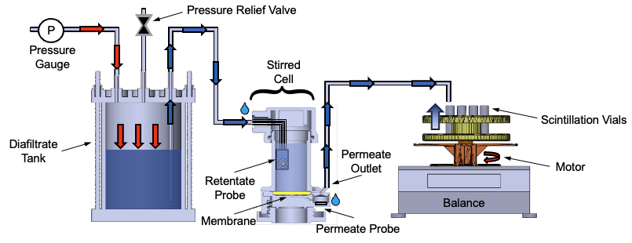
Plan for a Digital Twin Testbed
From Parameter Estimation to Adaptive Experiment Design in Diafiltration Systems
Digital Model (Current Setup)
Keshav Kasturi Rangan
Group Meeting
April 2, 2026

Slide 2
01 · CODE STRUCTURE
01
How the workflow is organized — roots, trunk, branches
ROOTS — loaders
TRUNK — process
BRANCHES — outputs
loadmat(path)
model_construct_inter
plot_sim_comparison
DATA1 / DATA2 (.mat experiment files)
Pyomo IDAES model
mass + conc + (stirred-cell)
loadxlsx(path, sheet=…)
solve_model(...)
render_*_parameters_table
DATA3 / NF270 (.xlsx campaign files)
ParmEst + multistart
per-campaign param tables
Both return the same data_stru dict shape: data_config + data_raw[vial].
solve_mass_balance_only
plot_contour
σ=0 closed-form (litmus)
FIM heatmap / σ-sensitivity
calc_FIM(...)
render_nf270_fit_v2
data_config: n, n_v0, n_extra, n_h, n_A M_F0, M_O, C_F0, C_D delP, Temp, Am, rho Lp0, B0, sigma0, theta0 data_raw[i]: time, mass, cF_exp, cV_avg
Fisher-information uncertainty
NF270 saw-tooth + ICP overlay
compute_doe_metrics
report_paper_coverage
Pyomo.DoE D/A/E-optimality
checklist vs published figs
design_next_experiment
run_data3_time_series_plots
Model discrimination output
DATA3 custom-file figures
All public API in refactored_ucb_library.py. conductivity_paper.py is the only sibling, frozen.
NF270 fitting · diagnosis + fix + open questions for collaborators
1 / 10

Slide 3
02 · HOW TO RUN IT
02
The runfile asks four questions, then dispatches
1
ROOT — pick a data source
Choices:
Which campaign or file are you working from?
1 DATA1 2 DATA2 3 DATA3 / NF270 4 custom file
2
SUBSET — narrow within the root
Choices:
Within the chosen root, which sheets / files to run?
DATA3: all 26 | single-salt 11 | one sheet | fast 3
3
TRUNK — pick the workflow
Choices:
Simulate, fit, multistart, FIM, DoE, or mass-litmus.
0 manifest default 3 fit+multistart 4 + FIM 5 + DoE 6 mass-litmus
4
BRANCHES — choose outputs
Choices:
Which plots / tables to produce.
m mass c conc p params f FIM heatmap d DoE all
→ DISPATCH: materialize_all(...) for DATA1 / DATA2 / DATA3, or run_pipeline(...) for custom files.
NF270 fitting · diagnosis + fix + open questions for collaborators
2 / 10

Slide 4
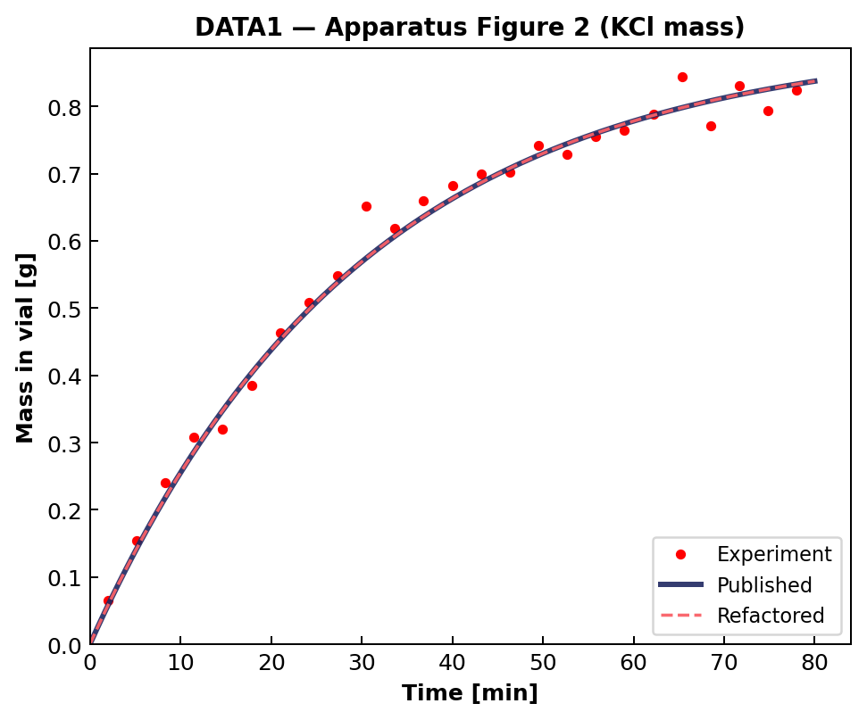
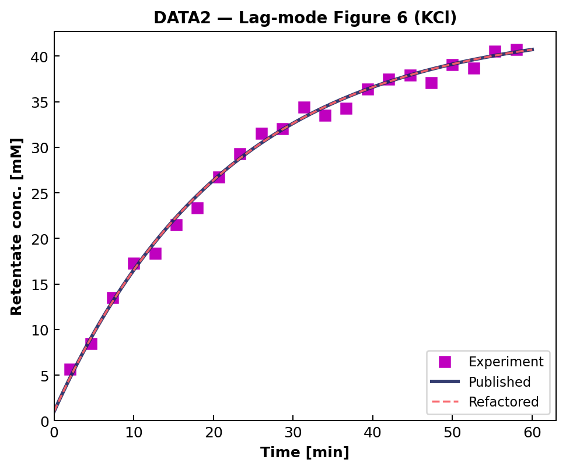
03 · REPRODUCIBILITY
03
Byte-identical replication of DATA1 + DATA2 published figures
DATA1 — Apparatus Figure 2 (KCl mass vs time)
DATA2 — Lag-mode Figure 6 (KCl retentate cF)
manifest_default calls materialize_all with the exact same args the legacy runfile used — no extra_opts overrides flow through; conductivity_paper.py stays frozen.
NF270 fitting · diagnosis + fix + open questions for collaborators
3 / 10

Slide 5
04 · DATA3 FIRST RUN
04
DATA3 first run: same code, three salts — three distinct failure patterns
First DATA3 fit on the 11 single-salt sheets. Same WSSE objective: Obj = 1e4 · ( Σ (Δm/0.01)²/N_m + Σ (Δcv/(0.03·cv))²/N_v + Σ (Δcf/(0.003·cf))²/N_r ). Three distinct failure patterns appear — all σ-pathologies, not data bugs:
MODE A — moderate σ↑
MODE B — σ → 1.0 (degenerate)
MODE C — σ↓, over-prediction
MASS
MASS
MASS
vial-1 prediction overshoots to ~1.5 g; vials 2-10 plateau at 0.7-0.95 g (below the 1.0 g cap).
predictions explode to 6-10 g per vial; model thinks much more permeate is flowing than the balance shows.
predictions overshoot to 6-12 g per vial — same direction as Mode B but conc plot tells a different story.
CONCENTRATION
CONCENTRATION
CONCENTRATION
predicted retentate matches measured retentate; predicted vial under-predicts ICP-OES by ~30 %.
predicted retentate severely under-predicts (8 vs 22 mM); predicted vial = 0 across the run.
predicted retentate > measured retentate (60 vs 43 mM); predicted vial > ICP — model lets too much salt through.
NF270 fitting · diagnosis + fix + open questions for collaborators
4 / 10

Slide 6
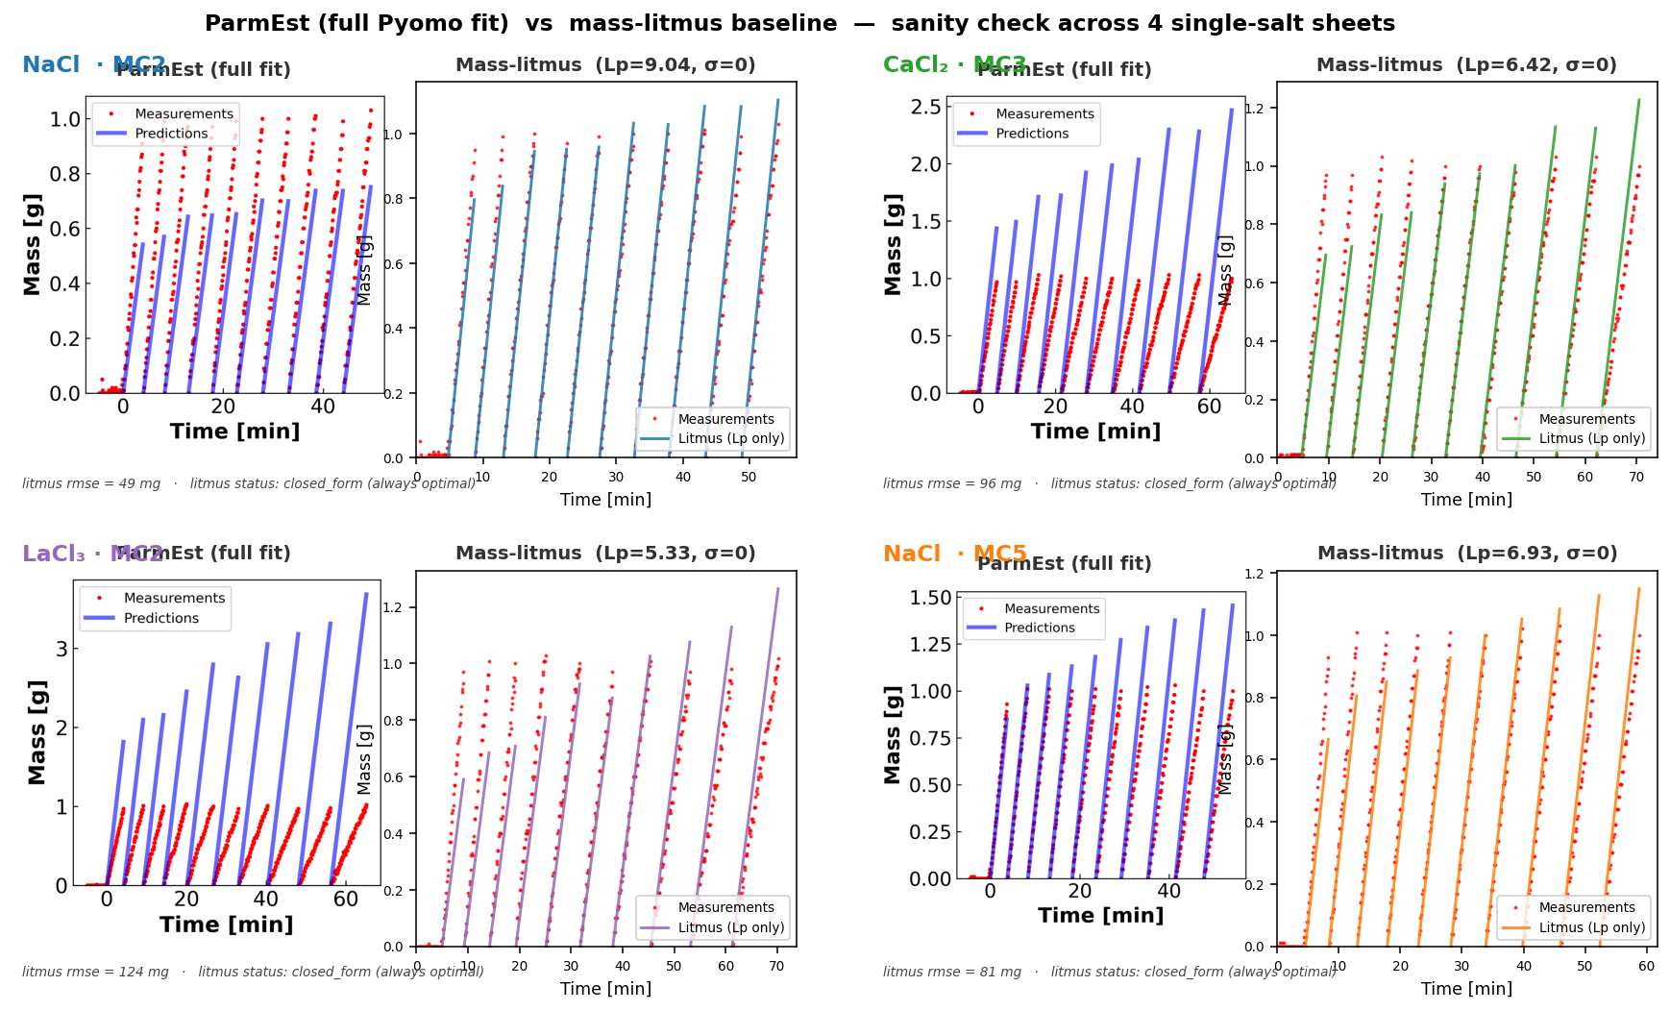
05 · MASS-LITMUS BASELINE
05
Bad ParmEst fit vs mass-litmus baseline — σ=0 closed-form Lp regression
Left = ParmEst full fit (σ released, B fitted, IPOPT) — landed in the Mode B σ=1 corner. Right = mass-litmus baseline: σ=0, B dropped, Lp from closed-form regression Lp = slope · 36000 / (Am · ρ · ΔP) where slope = Σ(Δt · m) / Σ(Δt²). Always optimal by construction. The baseline beats the full fit → σ/B parameters are not yet doing useful work; landscape problem, not model problem.
NF270 fitting · diagnosis + fix + open questions for collaborators
5 / 10

Slide 7
06 · LHS MULTISTART
06
R10 + R12 — Latin Hypercube multistart over (Lp, σ, B), narrowed boxes
Stage
Lp box (linear)
σ box
B / beta_0 box (log)
Basin found · Obj value
SINGLE START
Lp0 = 5
σ0 = 0.9
B0 = 0.5
Mode B (σ → 1) · Obj = 2.04 × 10⁸
LHS R10
[5, 14]
(0.10, 0.95) open
log [1e-6, 5]
Mode C (σ = 0) · Obj = 4.93 × 10⁷ (4× reduction)
LHS R12
[5, 8] narrowed
(0.10, 0.95) open
log [0.01, 5]
Mode B again · Obj = 6.08 × 10⁹ (cornered)
LHS samples and corner-hopping — what the math says
Latin-Hypercube: draw N starts so that, after permuting columns, each of the N strata along every axis contains exactly one sample. θ_k = θ_lo + LHS_unit[k] · (θ_hi - θ_lo). Better space coverage than IID for small N.
IPOPT is local. Multistart is a global-search heuristic: best_fit = argmin_{k=1..N} Obj(IPOPT(θ_k)) over optimal-status runs. Narrowing the LHS box keeps starts inside the physics window but doesn't restrict where IPOPT can terminate.
R10: factor-of-4 Obj cut by escaping Mode B. R12: tightening Lp to [5,8] removed the upper-Lp draws but the σ=1 corner remains attractive when loss-function structure prefers it. Landscape fix has to come from new observables, not box-tightening alone.
Pyomo Var bounds remain wider than the LHS box: Lp ∈ (0.5, 50), B ∈ (1e-6, 30), σ ∈ (0, 1). LHS just controls trial starts; if a corner solution is the true global minimum it will still be reached. The next two slides tackle the loss-function side.
NF270 fitting · diagnosis + fix + open questions for collaborators
6 / 10

Slide 8
07 · MASS SCALING
07
Tried per-sheet quadrature (R11) → reverted to DATA2's 0.01 g convention (R13)
WSSE MASS TERM — frequentist / MLE reading:
obj_m = Σ_i ( (m_pred_i − m_meas_i) / mass_scale_g )² / N_m
Under Gaussian noise N(0, σ²) on m, this is the negative log-likelihood up to a constant. mass_scale_g IS σ — the standard deviation of the noise on a single balance reading. It is a property of the instrument, not of the salt.
R11 — tried per-sheet quadrature
R13 — reverted to DATA2 convention
mass_scale_g = sqrt( σ_balance² + (α · |M_F0 − Final|)² ), α = 0.05.
Idea: salt-aware scaling so NaCl/CaCl₂/LaCl₃ each get a sensible mass weight. NaCl: 0.020 g · CaCl₂: 0.013 g · LaCl₃: 0.011 g.
Result: Obj jumped from 4.93×10⁷ (LHS R10) to 6.08×10⁹ on NaCl-MC2 — looser mass term let optimizer slide to σ=1 corner. The α·|signal| term was Bayesian regularization in disguise.
mass_scale_g = MASS_BALANCE_SIGMA_G = 0.01 g, salt-independent, sheet-independent — matches DATA2 published convention.
Frequentist justification: σ_balance is a property of the analytical balance, not of the salt. Reweighting the loss function per salt would mean "different noise model per salt" — physically wrong.
Salt-specific physics belongs in the parameters (θ = (Lp, B, σ)), not in the noise model.
DATA1 / DATA2 stay byte-identical: both objectives use data_stru['data_config'].get('mass_scale_g', 0.01), so missing field → 0.01 g. Path forward: add observables (next slide), not new weights.
NF270 fitting · diagnosis + fix + open questions for collaborators
7 / 10

Slide 9
08 · NEW OBSERVABLES
08
Sidebar ICP-OES (R14) + Final Tube anchor in WSSE (R15)
WHAT WAS HIDDEN — sidebar cols 14-21
FINAL TUBE ICP — per sheet (R14)
Feed / Diafiltrate / Retentate / Final Tube ICP rows — ignored by old loader.
Conversion (per row): c [mM] = ICP [mg/L] · (V_samp + V_acid) / V_samp / cation_MW [g/mol].
Stoichiometry: 1 cation / formula unit holds for NaCl, KCl, CaCl₂, LaCl₃ → c [mM of salt] = c [mM of cation].
R15 anchor (added to both obj_rule functions): obj_cf += ((cF[N, τ_last] − Final_Tube_ICP) / (0.003 · Final_Tube_ICP))².
Same 0.3% relative weighting DATA2 uses for per-sample cF. R16 also parses RPM from notes.
icp_final_mM is None / ≤0 → anchor silently skipped (DATA1/DATA2 unchanged).
NaCl-MC2 cF_final
23.9 mM
CaCl₂-MC2 cF_final
25.1 mM
LaCl₃-MC2 cF_final
0.99 mM
S2NaCl-MC5 cF_final
8.32 mM
SLaCl₃-MC4 cF_final
−0.001 mM (skip)
SNaCl-MC4 cF_final
86.6 mM
NF270 fitting · diagnosis + fix + open questions for collaborators
8 / 10

Slide 10
09 · OPEN QUESTIONS
09
Open questions — frequentist, no priors; corner-hopping still in play
Q1
σ reparameterization?
Should we reparameterize σ = exp(η)/(1+exp(η)), η ∈ ℝ, to eliminate the {σ=0, σ=1} corners? Frequentist-neutral (pure change of variables in the parameter space).
experimental
Q2
Two-stage fit?
Profile-likelihood approach: lock Lp from mass-litmus (Lp̂ = slope · 36000 / (Am · ρ · ΔP)), then fit (σ, B) on concentration only. Equivalent to a frequentist profile over the Lp axis.
computational
Q3
Interior σ box?
Tighten Pyomo Var bound from σ ∈ (0,1) to σ ∈ [0.30, 0.85]. If Obj jumps back up after constraining the interior, the corners are global minima → model is mis-specified.
computational
Q4
Retentate weight?
Is 0.3% the right standard deviation for the in-line retentate conductivity probe? If actual noise is 1-2%, the cF term currently dominates the WSSE by 9-44× relative to truth. Easy sensitivity test.
both
NF270 fitting · diagnosis + fix + open questions for collaborators
9 / 10

Slide 11

01 · CODE STRUCTURE
01
How the workflow is organized — roots, trunk, branches
ROOTS — loaders
TRUNK — process
BRANCHES — outputs
loadmat(path)
model_construct_inter
plot_sim_comparison
DATA1 / DATA2 (.mat experiment files)
Pyomo IDAES model
mass + conc + (stirred-cell)
loadxlsx(path, sheet=…)
solve_model(...)
render_*_parameters_table
DATA3 / NF270 (.xlsx campaign files)
ParmEst + multistart
per-campaign param tables
Both return the same data_stru dict shape: data_config + data_raw[vial].
solve_mass_balance_only
plot_contour
σ=0 closed-form (litmus)
FIM heatmap / σ-sensitivity
calc_FIM(...)
render_nf270_fit_v2
data_config: n, n_v0, n_extra, n_h, n_A M_F0, M_O, C_F0, C_D delP, Temp, Am, rho Lp0, B0, sigma0, theta0 data_raw[i]: time, mass, cF_exp, cV_avg
Fisher-information uncertainty
NF270 saw-tooth + ICP overlay
compute_doe_metrics
report_paper_coverage
Pyomo.DoE D/A/E-optimality
checklist vs published figs
design_next_experiment
run_data3_time_series_plots
Model discrimination output
DATA3 custom-file figures
All public API in refactored_ucb_library.py. conductivity_paper.py is the only sibling, frozen.
1

Slide 12
02 · HOW TO RUN IT
02
The runfile asks four questions, then dispatches
1
ROOT — pick a data source
Choices:
Which campaign or file are you working from?
1 DATA1 2 DATA2 3 DATA3 / NF270 4 custom file
2
SUBSET — narrow within the root
Choices:
Within the chosen root, which sheets / files to run?
DATA3: all 26 | single-salt 11 | one sheet | fast 3
3
TRUNK — pick the workflow
Choices:
Simulate, fit, multistart, FIM, DoE, or mass-litmus.
0 manifest default 3 fit+multistart 4 + FIM 5 + DoE 6 mass-litmus
4
BRANCHES — choose outputs
Choices:
Which plots / tables to produce.
m mass c conc p params f FIM heatmap d DoE all
→ DISPATCH: materialize_all(...) for DATA1 / DATA2 / DATA3, or run_pipeline(...) for custom files.
2

Slide 13
03 · REPRODUCIBILITY
03
Byte-identical replication of DATA1 + DATA2 published figures
DATA1 — Apparatus Figure 2 (KCl mass vs time)
DATA2 — Lag-mode Figure 6 (KCl retentate cF)
manifest_default calls materialize_all with the exact same args the legacy runfile used — no extra_opts overrides flow through; conductivity_paper.py stays frozen.
3

Slide 14
04 · DATA3 FIRST RUN
04
DATA3 first run: same code, three salts — three distinct failure patterns
First DATA3 fit on the 11 single-salt sheets. Same WSSE objective: Obj = 1e4 · ( Σ (Δm/0.01)²/N_m + Σ (Δcv/(0.03·cv))²/N_v + Σ (Δcf/(0.003·cf))²/N_r ). Three distinct failure patterns appear — all σ-pathologies, not data bugs:
MODE A — moderate σ↑
MODE B — σ → 1.0 (degenerate)
MODE C — σ↓, over-prediction
MASS
MASS
MASS
vial-1 prediction overshoots to ~1.5 g; vials 2-10 plateau at 0.7-0.95 g (below the 1.0 g cap).
predictions explode to 6-10 g per vial; model thinks much more permeate is flowing than the balance shows.
predictions overshoot to 6-12 g per vial — same direction as Mode B but conc plot tells a different story.
CONCENTRATION
CONCENTRATION
CONCENTRATION
predicted retentate matches measured retentate; predicted vial under-predicts ICP-OES by ~30 %.
predicted retentate severely under-predicts (8 vs 22 mM); predicted vial = 0 across the run.
predicted retentate > measured retentate (60 vs 43 mM); predicted vial > ICP — model lets too much salt through.
4

Slide 15
05 · MASS-LITMUS BASELINE
05
Bad ParmEst fit vs mass-litmus baseline — σ=0 closed-form Lp regression
Left = ParmEst full fit (σ released, B fitted, IPOPT) — landed in the Mode B σ=1 corner. Right = mass-litmus baseline: σ=0, B dropped, Lp from closed-form regression Lp = slope · 36000 / (Am · ρ · ΔP) where slope = Σ(Δt · m) / Σ(Δt²). Always optimal by construction. The baseline beats the full fit → σ/B parameters are not yet doing useful work; landscape problem, not model problem.
5

Slide 16
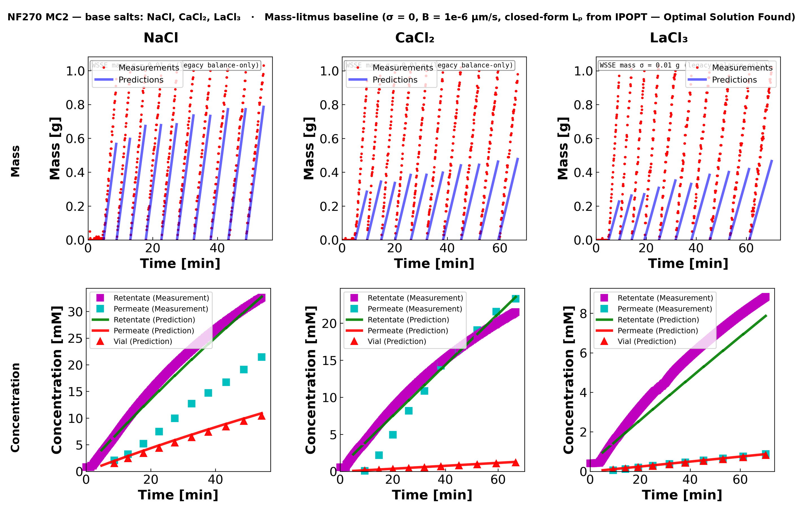
05A · MC2
06
NF270 MC2 — base salts (NaCl, CaCl₂, LaCl₃)
The base-salts panel — what you asked about. Same code, three different cation valences, on the same membrane coupon. Mass-litmus baseline (σ = 0, B = 1e-6) — this is the σ = 0 corner. NaCl mass slope is under-predicted; LaCl₃ best.
6

Slide 17
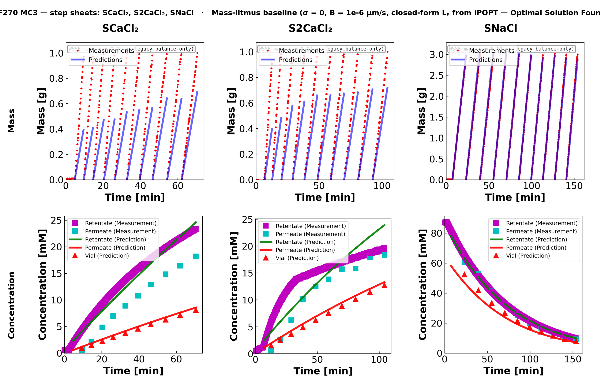
05B · MC3
07
NF270 MC3 — step sheets (SCaCl₂, S2CaCl₂, SNaCl)
Second NF270 coupon, three step sheets. Mass-litmus reads similar Lₚ to MC2; SNaCl shows the strongest mass under-prediction (high baseline permeate flow).
7

Slide 18
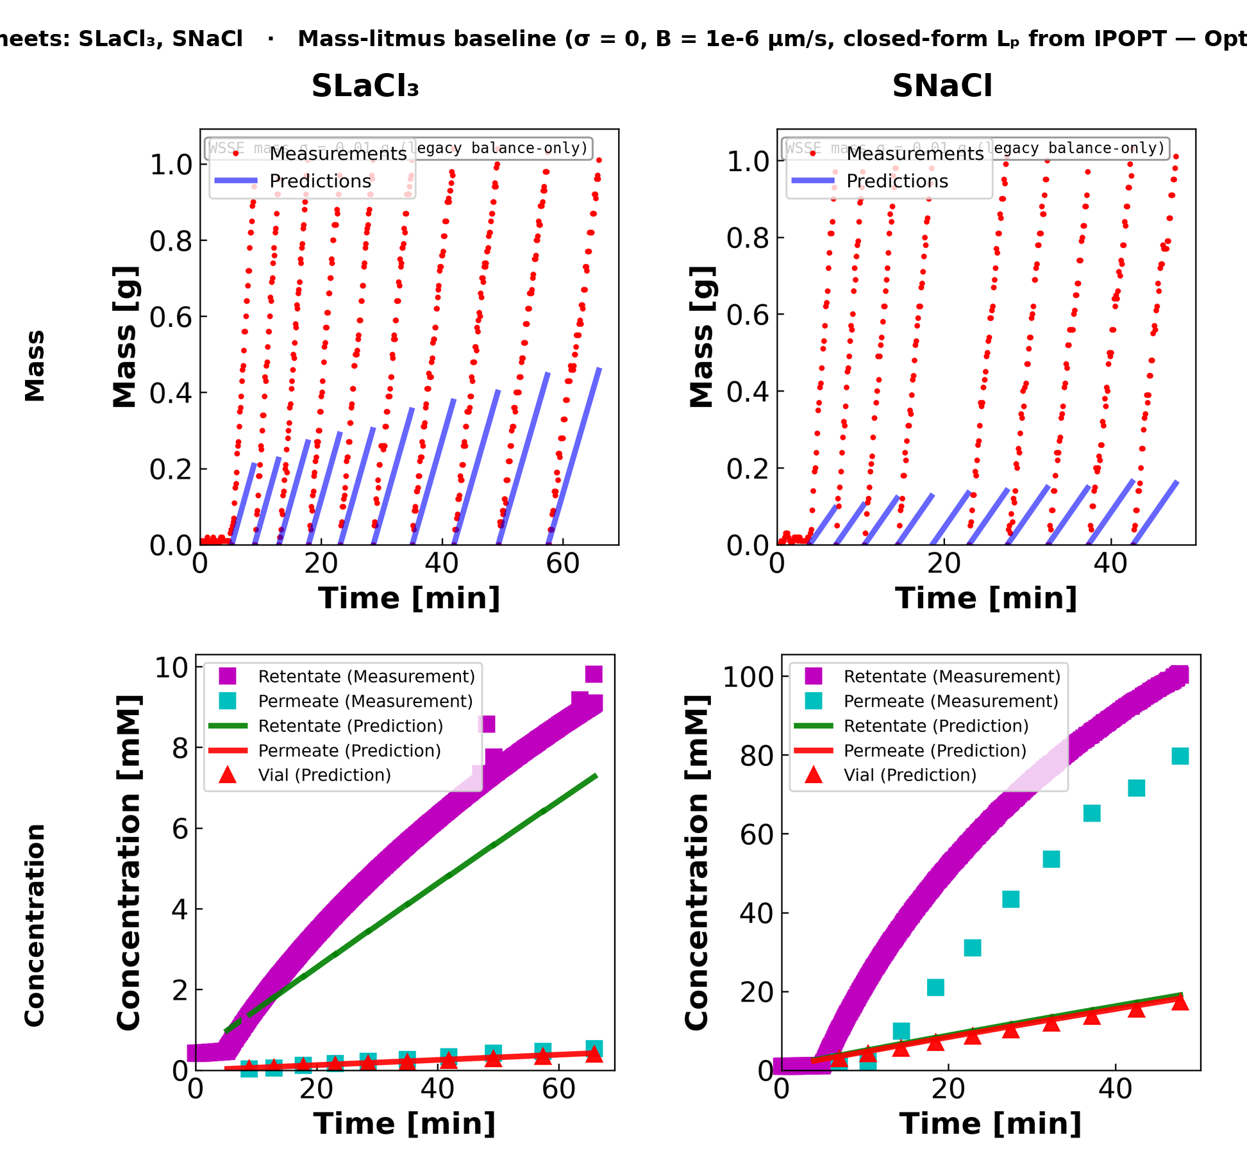
05C · MC4
08
NF270 MC4 — step sheets (SLaCl₃, SNaCl)
Third coupon, two step sheets only (SLaCl₃ + SNaCl). LaCl₃ rejection again very high — Final-Tube ICP read ≈ −0.001 mM here, so the R15 anchor is silently skipped on this sheet.
8

Slide 19
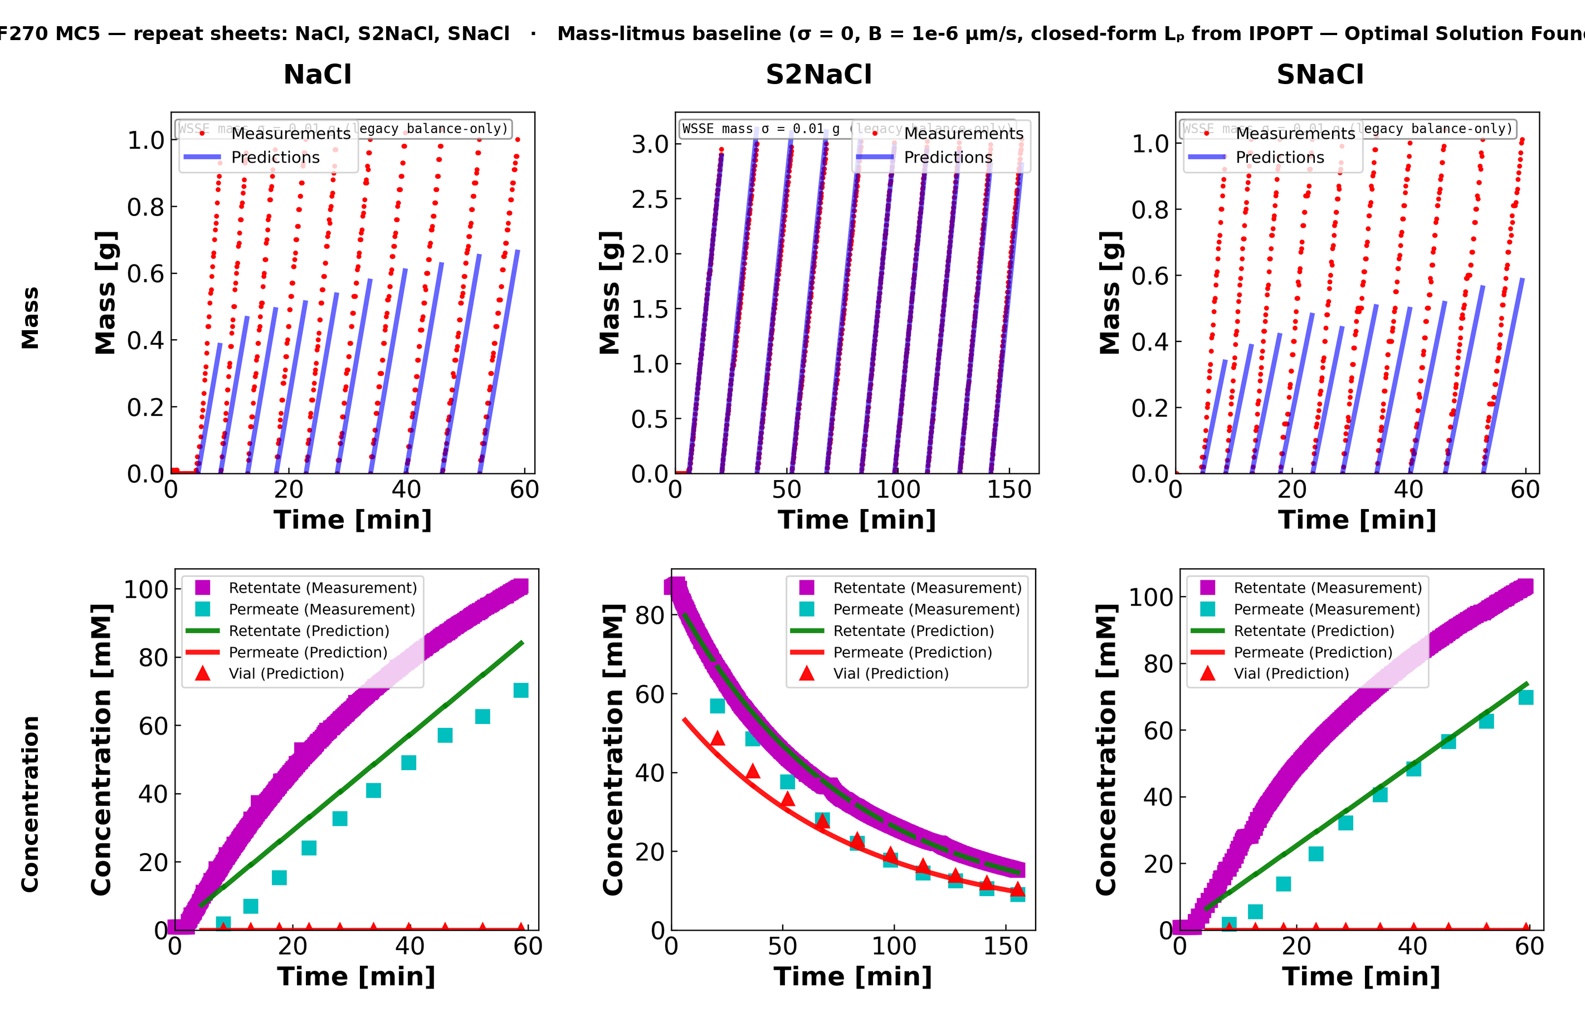
05D · MC5
09
NF270 MC5 — repeat sheets (NaCl, S2NaCl, SNaCl)
Fourth coupon, three repeat NaCl variants. S2NaCl is the diluting-experiment sheet (100 mM Feed, 0 mM Diafiltrate) — that is why the retentate is decreasing.
9

Slide 20
06 · LHS MULTISTART
06
R10 + R12 — Latin Hypercube multistart over (Lp, σ, B), narrowed boxes
Stage
Lp box (linear)
σ box
B / beta_0 box (log)
Basin found · Obj value
SINGLE START
Lp0 = 5
σ0 = 0.9
B0 = 0.5
Mode B (σ → 1) · Obj = 2.04 × 10⁸
LHS R10
[5, 14]
(0.10, 0.95) open
log [1e-6, 5]
Mode C (σ = 0) · Obj = 4.93 × 10⁷ (4× reduction)
LHS R12
[5, 8] narrowed
(0.10, 0.95) open
log [0.01, 5]
Mode B again · Obj = 6.08 × 10⁹ (cornered)
LHS samples and corner-hopping — what the math says
Latin-Hypercube: draw N starts so that, after permuting columns, each of the N strata along every axis contains exactly one sample. θ_k = θ_lo + LHS_unit[k] · (θ_hi - θ_lo). Better space coverage than IID for small N.
IPOPT is local. Multistart is a global-search heuristic: best_fit = argmin_{k=1..N} Obj(IPOPT(θ_k)) over optimal-status runs. Narrowing the LHS box keeps starts inside the physics window but doesn't restrict where IPOPT can terminate.
R10: factor-of-4 Obj cut by escaping Mode B. R12: tightening Lp to [5,8] removed the upper-Lp draws but the σ=1 corner remains attractive when loss-function structure prefers it. Landscape fix has to come from new observables, not box-tightening alone.
Pyomo Var bounds remain wider than the LHS box: Lp ∈ (0.5, 50), B ∈ (1e-6, 30), σ ∈ (0, 1). LHS just controls trial starts; if a corner solution is the true global minimum it will still be reached. The next two slides tackle the loss-function side.
6

Slide 21
07 · MASS SCALING
07
Tried per-sheet quadrature (R11) → reverted to DATA2's 0.01 g convention (R13)
WSSE MASS TERM — frequentist / MLE reading:
obj_m = Σ_i ( (m_pred_i − m_meas_i) / mass_scale_g )² / N_m
Under Gaussian noise N(0, σ²) on m, this is the negative log-likelihood up to a constant. mass_scale_g IS σ — the standard deviation of the noise on a single balance reading. It is a property of the instrument, not of the salt.
R11 — tried per-sheet quadrature
R13 — reverted to DATA2 convention
mass_scale_g = sqrt( σ_balance² + (α · |M_F0 − Final|)² ), α = 0.05.
Idea: salt-aware scaling so NaCl/CaCl₂/LaCl₃ each get a sensible mass weight. NaCl: 0.020 g · CaCl₂: 0.013 g · LaCl₃: 0.011 g.
Result: Obj jumped from 4.93×10⁷ (LHS R10) to 6.08×10⁹ on NaCl-MC2 — looser mass term let optimizer slide to σ=1 corner. The α·|signal| term was Bayesian regularization in disguise.
mass_scale_g = MASS_BALANCE_SIGMA_G = 0.01 g, salt-independent, sheet-independent — matches DATA2 published convention.
Frequentist justification: σ_balance is a property of the analytical balance, not of the salt. Reweighting the loss function per salt would mean "different noise model per salt" — physically wrong.
Salt-specific physics belongs in the parameters (θ = (Lp, B, σ)), not in the noise model.
DATA1 / DATA2 stay byte-identical: both objectives use data_stru['data_config'].get('mass_scale_g', 0.01), so missing field → 0.01 g. Path forward: add observables (next slide), not new weights.
7

Slide 22
08 · NEW OBSERVABLES
08
Sidebar ICP-OES (R14) + Final Tube anchor in WSSE (R15)
WHAT WAS HIDDEN — sidebar cols 14-21
FINAL TUBE ICP — per sheet (R14)
Feed / Diafiltrate / Retentate / Final Tube ICP rows — ignored by old loader.
Conversion (per row): c [mM] = ICP [mg/L] · (V_samp + V_acid) / V_samp / cation_MW [g/mol].
Stoichiometry: 1 cation / formula unit holds for NaCl, KCl, CaCl₂, LaCl₃ → c [mM of salt] = c [mM of cation].
R15 anchor (added to both obj_rule functions): obj_cf += ((cF[N, τ_last] − Final_Tube_ICP) / (0.003 · Final_Tube_ICP))².
Same 0.3% relative weighting DATA2 uses for per-sample cF. R16 also parses RPM from notes.
icp_final_mM is None / ≤0 → anchor silently skipped (DATA1/DATA2 unchanged).
NaCl-MC2 cF_final
23.9 mM
CaCl₂-MC2 cF_final
25.1 mM
LaCl₃-MC2 cF_final
0.99 mM
S2NaCl-MC5 cF_final
8.32 mM
SLaCl₃-MC4 cF_final
−0.001 mM (skip)
SNaCl-MC4 cF_final
86.6 mM
8

Slide 23
09 · OPEN QUESTIONS
09
Open questions — frequentist, no priors; corner-hopping still in play
Q1
σ reparameterization?
Should we reparameterize σ = exp(η)/(1+exp(η)), η ∈ ℝ, to eliminate the {σ=0, σ=1} corners? Frequentist-neutral (pure change of variables in the parameter space).
experimental
Q2
Two-stage fit?
Profile-likelihood approach: lock Lp from mass-litmus (Lp̂ = slope · 36000 / (Am · ρ · ΔP)), then fit (σ, B) on concentration only. Equivalent to a frequentist profile over the Lp axis.
computational
Q3
Interior σ box?
Tighten Pyomo Var bound from σ ∈ (0,1) to σ ∈ [0.30, 0.85]. If Obj jumps back up after constraining the interior, the corners are global minima → model is mis-specified.
computational
Q4
Retentate weight?
Is 0.3% the right standard deviation for the in-line retentate conductivity probe? If actual noise is 1-2%, the cF term currently dominates the WSSE by 9-44× relative to truth. Easy sensitivity test.
both
9

Slide 24
Backup Files
📎

Slide 25
10 · REPRODUCE
10
How to run this on your machine — five steps
STEPS
1. Drop in refactored_ucb_library.py and refactored_ucb_runfile.py (single consolidated files).
2. python refactored_ucb_runfile.py pick ROOT=3 (NF270) SUBSET=2 (single-salt) TRUNK=6 (mass-litmus)
3. Verify data_config: vial1_split_status=="split", Lp0_method=="data_driven", icp_final_tube_mM is populated.
4. Re-run TRUNK=3 with N=5 LHS starts. Report fitted (Lp̂, B̂, σ̂) per sheet + final Obj + Final Tube residual.
5. Verify data_config carries: mass_scale_g=0.01, icp_*_mM, stir_rpm. Compute mass-litmus baseline Lp = slope·36000/(Am·ρ·ΔP); confirm full fit beats it.
WHAT WOULD HELP US MOST
WHAT TO WATCH FOR
Your priors on σ for NF270 with NaCl, CaCl₂, LaCl₃ — even rough ranges.
Whether the three modes correspond to specific salts you've seen behave this way.
Which sheet you'd focus on first if you were us.
σ̂ → 1 with Lp̂ → 0.5 (lower bound) — Mode B corner.
σ̂ → 0 with B̂ → large — Mode C corner (LHS-R10 basin).
Final Tube residual (cF[N,τ_last]−ICP) on the order of σ_cf = 0.003·cF → fit consistent with measurement.
10

Slide 26
B01 · PROBLEM STATEMENT
11
Dynamic inverse problem — what we are solving for
UNKNOWNS
OPTIMIZATION
θ = ( Lp , B , σ ) Lp : hydraulic permeability [ L / m² / hr / bar ] B : solute permeability [ μm / s ] σ : reflection coefficient [ dimensionless, 0 ≤ σ ≤ 1 ] Measurements per vial i and sample j: mV_i,j : mass collected in vial i at time t_j [g] cF_i,j : retentate concentration [mM] cV_i : per-vial permeate concentration (scalar) [mM]
θ̂ = argmin_θ Obj(θ ; D) subject to: DAE & initial conditions parameter bounds The model outputs (mV, cF, cV) are not algebraic in θ. They come from solving coupled ODEs over (n_vial, τ). Pyomo turns the dynamic model into one nonlinear program over { θ, all state values at all τ-nodes }.
KEY POINT — WHY THE FIT IS HARD
1. The forward map θ → ( mV, cF, cV ) is nonlinear and dynamic. Even small θ-changes can shift basins → IPOPT can converge to different local minima depending on initialization. 2. σ has both lower (σ = 0, no rejection) and upper (σ = 1, complete rejection) corner basins. Each corner trivializes the model in a different way, and is hard to escape once the optimizer is nearby. Hence LHS multistart (R10/R12) and structural fixes. 3. The WSSE weights (1 / σ_meas) determine which residual the optimizer cares about most. Salt-specific physics belongs in θ, not in σ_meas — see R11→R13 in slide 7.
11

Slide 27
B02 · DATA CONTRACT
12
data_stru — one shape, two loaders (loadmat, loadxlsx)
data_config (per experiment)
data_raw[i] (one entry per vial)
n # number of vials n_v0 # first real (non-holdup) vial n_extra # holdup vials skipped in WSSE delP # applied pressure [bar] Temp # temperature [K] Am # membrane area [cm²] rho # density [g/cm³] M_F0 # initial feed mass [g] M_O # M_F0 − Final [g] C_F0 # initial feed conc. [mM] C_D # diafiltrate conc. [mM] namec # salt name (e.g. "NaCl") Lp0, B0, sigma0 # initial guesses mass_scale_g # WSSE mass weight, 0.01 g stir_rpm # R16, parsed from notes icp_feed_mM icp_diafiltrate_mM icp_retentate_mM icp_final_tube_mM # R14/R15 anchor
time # sample times [s], per-vial start at 0 mass # cumulative balance reading, per-vial reset: # mass[t] = balance[t] − balance[t_start] # (matches DATA2 .mat convention) cF_exp # retentate concentration time-series [mM] # (Shedlovsky-inverted from in-line κ) cV_avg # scalar per-vial permeate conc. [mM] # = mg/L · dilution / cation_MW Both loaders converge to this shape: loadmat("…/data_stru-dataset270511.12.mat") ↓ data_stru = {"data_config": …, "data_raw": […]} ↑ _load_legacy_data_stru_from_excel("NF270_MC2.xlsx", selector="05.07.24_NaCl") Downstream code (solve_model, calc_FIM, plot_*) never knows whether the source was .mat or .xlsx.
12

Slide 28
B03 · PHYSICS MODEL
13
Lumped-parameter membrane transport — what each θ does
Lₚ
Hydraulic permeability
B
Solute permeability
σ
Reflection coefficient
L / (m² · hr · bar) sets J_w against ΔP
μm / s sets diffusive solute flux J_s
0..1 sets the osmotic backpressure
WATER FLUX J_w [cm/s]
SOLUTE FLUX J_s [mol/(cm²·s)]
CONCENTRATION POLARIZATION
J_w · 36000 = Lₚ · [ ΔP − σ · n_i · R · T · ( c_in − c_H ) ]
J_s · 10000 = B · ( c_in − c_H )
c_in = ( c_F − c_H ) · exp( J_w / k ) + c_H
m.Jw[n,t] · 36000 == m.Lp · (delP − (m.cIn − m.cH) · ni · m.sigma · R · T)
single-B form: m.Js[n,t] · 10000 == m.B · (m.cIn − m.cH)
k = 0.23 · v^0.57 · D^0.67 / (ν^0.24 · b^0.43), v = (RPM/60) · π · b
DIAFILTRATE (constant)
STIRRED CELL (feed)
HOLDUP (m_H = 0.25 mL)
COLLECTING VIAL
c_D = const (mM) M_D → pumped in at S S fit during holdup (Lag mode only)
dm_F / dt = − S₀ − A_m · ρ · J_w (Lag, post-holdup) dm_F / dt = + S / 3600 (Lag, in holdup) dc_F / dt = ( A_m · ρ / m_F ) · ( c_D · J_w − J_s )
dc_H / dt = ( A_m · ρ / m_H ) · ( J_s − c_H · J_w ) c_in = (c_F − c_H) exp(J_w/k) + c_H ↑ algebraic constraint
dm_V / dt = A_m · ρ · J_w d(c_V · m_V)/dt = A_m · ρ · J_w · c_H c_V = (c_V · m_V) / m_V ↑ avoids 0/0 at vial start
Parameter estimation problem: θ̂ = argmin_θ Σ ( y_meas − h(x(θ), t) )² / σ_meas² subject to the DAEs above
13

Slide 29
B04 · DYNAMIC STATES
14
Pyomo states + the cVmV trick (avoiding 0/0)
STATES
WHY cVmV AND NOT cV DIRECTLY?
m.cF [n_vial, τ] retentate / feed concentration [mM] m.cH [n_vial, τ] holdup concentration [mM] m.mV [n_vial, τ] cumulative vial mass [g] m.cVmV [n_vial, τ] extensive vial solute c_V · m_V m.cV [n_vial, τ] vial concentration [mM] Algebraic constraint: m.cV [n,t] · m.mV [n,t] == m.cVmV [n,t] Domains: m.n_vial = RangeSet(N_VIAL) m.tau = ContinuousSet(bounds=(0, 1)) Derivatives (Pyomo DAE): m.dcF = DerivativeVar(m.cF, wrt=m.tau) m.dcH = DerivativeVar(m.cH, wrt=m.tau) m.dmV = DerivativeVar(m.mV, wrt=m.tau) m.dcVmV = DerivativeVar(m.cVmV, wrt=m.tau)
At the start of each vial, m_V → 0. Computing c_V = c_VmV / m_V is singular there. Trick: evolve the EXTENSIVE quantity first, then recover the intensive variable algebraically: d(c_V · m_V) / dt = A_m · ρ · J_w · c_H (well-defined) c_V = (c_V · m_V) / m_V (algebraic, only evaluated where m_V > 0) This is a classic dynamic-modeling pattern: keep ODEs on extensive quantities (mass, total solute) and use algebraic constraints for intensive quantities (concentrations). Numerical payoff: IPOPT does not have to chase 0 / 0 near τ = 0 in each vial — the constraint is always non-singular.
14

Slide 30
B05 · ODEs
15
States, derivatives, and the time-scaling factor
STATES & DERIVATIVES
VIAL MASS d m_V / d t
m.cF [n, τ] retentate / feed [mM] m.cH [n, τ] holdup [mM] m.mV [n, τ] cumulative vial mass [g] m.cVmV [n, τ] extensive solute c_V · m_V m.cV [n, τ] vial concentration [mM] derivatives via Pyomo DAE: m.dcF = DerivativeVar(m.cF, wrt=m.tau) m.dcH = DerivativeVar(m.cH, wrt=m.tau) m.dmV = DerivativeVar(m.mV, wrt=m.tau) m.dcVmV = DerivativeVar(m.cVmV, wrt=m.tau) algebraic recovery: c_V · m_V = c_VmV (well-defined at m_V = 0)
d m_V / d t = A_m · ρ · J_w
VIAL SOLUTE d (c_V · m_V) / d t
d (c_V · m_V) / d t = A_m · ρ · J_w · c_H
HOLDUP CONCENTRATION d c_H / d t
d c_H / d t = ( A_m · ρ / m_H ) · ( J_s − c_H · J_w )
FEED CONCENTRATION d c_F / d t (DATA mode)
d c_F / d t = ( A_m · ρ / M_F0 ) · ( c_D · J_w − J_s )
TIME-SCALING FACTOR — chain rule
Every Pyomo ODE is multiplied by (TF[n] − TI[n]) / Tauf because τ ∈ [0,1] is rescaled time: dx / dτ = (TF − TI) · dx / dt (chain rule, Tauf = 1) Drop the factor and the dynamics fit the wrong time-window.
15

Slide 31
B06 · TIME SCALING
16
τ ∈ [0, 1] per vial — why every ODE has a (TF−TI) factor
WHY NORMALIZE?
CHAIN RULE — WHERE THE FACTOR COMES FROM
Different vials run for different durations. Vial 1 might be 8.6 min, vial 5 might be 4.8 min. If we worked in physical seconds, each ODE in each vial would have a different integration window. Pyomo DAE wants a single ContinuousSet shared across all vials. Solution: rescale each vial to τ ∈ [0, 1]: t ∈ [ TI[n] , TF[n] ] → τ = ( t − TI ) / ( TF − TI ) m.tau = ContinuousSet( bounds=(0, Tauf=1) ) Same τ grid is reused for every vial — cleaner discretization, smaller global problem, better numerical conditioning.
dx / dt = ( dx / dτ ) · ( dτ / dt ) dτ / dt = 1 / ( TF − TI ) so: dx / dτ = ( TF − TI ) · ( dx / dt ) That is why every Pyomo ODE in this code is multiplied by (TF_dict[n] − TI_dict[n]) / Tauf It is NOT a free unit-conversion factor — it is the chain-rule artifact of rescaling time to a unit interval. Drop it, and IPOPT silently fits the wrong dynamics.
16

Slide 32
B07 · DAE → NLP
17
Backward finite difference, nfe = 300, CasADi initialization
DISCRETIZATION
WHY THIS BEATS sim+opt
TransformationFactory("dae.finite_difference") .apply_to( instance, nfe = 300, scheme = "BACKWARD" ) The continuous ODE d x / d τ = f ( x, θ ) becomes: ( x[k] − x[k−1] ) / Δτ = f ( x[k], θ ) k = 1 .. nfe with Δτ = 1 / nfe = 1 / 300. Number of NLP variables ≈ N_VIAL × ( nfe + 1 ) × N_states = 11 × 301 × 7 ≈ 23,000 plus θ. The DAE is replaced by ~20,000 algebraic equality constraints.
Naive approach (NOT used here): for each θ proposal: y_sim = scipy.integrate.solve_ivp( ODE, θ ) obj = ‖ y_sim − y_meas ‖² minimize obj via scipy.optimize Problems: derivatives are noisy (finite-diff through the integrator), nested loops are slow, no guarantee of constraint satisfaction during the search. Simultaneous dynamic optimization (what this code does): min Obj(θ, x(·)) s.t. every ODE point IS an equality constraint every initial / boundary condition IS a constraint parameter bounds via Var( bounds = ... ) IPOPT moves θ AND the state grid jointly — exact gradients via automatic differentiation through Pyomo + ASL. CasADi simulator gives a warm start before IPOPT runs.
17

Slide 33
B08 · WSSE OBJECTIVE
18
Weighted least squares — what IPOPT actually minimizes
WSSE OBJECTIVE Obj(θ ; D)
10⁴ · [ Σ_i ( (m_pred_i − m_meas_i) / σ_m )² / N_m + Σ_j ( (c_V_j − c_V_j_meas) / (0.03 · c_V_j_meas) )² / N_v + Σ_k ( (c_F_k − c_F_k_meas) / (0.003 · c_F_k_meas) )² / N_r + R15: ( (c_F[N, τ_last] − ICP_final) / (0.003 · ICP_final) )² ]
σ_m = mass_scale_g = 0.01 g (R13, frequentist balance precision; salt-independent)
MASS TERM
VIAL CONC. TERM
RETENTATE TERM ← strict
( Δm / σ_m )² / N_m
( Δc_V / (0.03 · c_V_meas) )² / N_v
( Δc_F / (0.003 · c_F_meas) )² / N_r
σ_m = 0.01 g is the analytical-balance precision. Under N(0, σ_m²) noise, this is MLE up to a constant.
3 % relative uncertainty on ICP-OES per-vial reads. Hits the optimizer at τ = τ_last for each real vial.
0.3 % relative uncertainty on in-line conductivity. 10× tighter than vial → cF dominates the WSSE.
INTERPOLATION ONTO MEASUREMENT TIMES
IPOPT discretizes onto its own τ-grid. Measurements live at experimental timestamps t_j. For each (n_vial, t_j_scaled), find bracketing nodes τ[k], τ[k+1] and linearly interpolate: ŷ ( t_j ) = y[k] + ( y[k+1] − y[k] ) · ( t_j − τ[k] ) / ( τ[k+1] − τ[k] ) Residuals are evaluated at ŷ(t_j), not at grid nodes. Same trick DATA2 utility.py uses.
18

Slide 34
B09 · IPOPT + MULTISTART
19
Local NLP solver wrapped in a Latin-Hypercube global heuristic
IPOPT call
LHS multistart (R10 + R12)
solver = _build_ipopt_solver() solver.options["max_iter"] = 3000 solver.options["linear_solver"] = ma57 / mumps results = solver.solve(instance, tee=True) On non-optimal termination, retry with MUMPS + more iter: solver.options["linear_solver"] = "mumps" solver.options["max_iter"] = 5000 solver.solve(instance, tee=True)
lhs = _lhs_unit_hypercube( N, d, seed = 13 ) for k in 1 .. N: θ_k = θ_lo + lhs[k, :] · ( θ_hi − θ_lo ) fit_k = solve_model( θ_k ) best = argmin_k Obj( fit_k ) over optimal-status runs Default N = 5 (runfile accepts 5 .. 14) Lp box = linear [ 5, 8 ] (R12 narrowing) B box = log [ 0.01, 5 ] μm/s σ box = linear ( 0.10, 0.95 ) corners excluded
OBSERVED OBJECTIVE PROGRESSION (NF270_MC2 / NaCl)
Single start Obj = 2.04 × 10⁸ basin: Mode B (σ → 1) LHS multistart (R10, Lp ∈ [5, 14]) Obj = 4.93 × 10⁷ basin: Mode C (σ → 0) LHS multistart (R11 quadrature mass) Obj = 6.08 × 10⁹ basin: Mode B (σ → 1) LHS narrowed (R12, Lp ∈ [5, 8]) + R13 Obj = 4.93 × 10⁷ basin: Mode C (σ → 0) LHS narrowed + R14/R15 Final-Tube anchor Obj = TBD (next run) The Pyomo Var bounds are wider than the LHS box (Lp ∈ (0.5, 50), σ ∈ (0,1)) — LHS only controls where trial starts land, not where IPOPT is allowed to terminate. Local optimum.
19

Slide 35
B10 · MASS-LITMUS BASELINE
20
σ = 0 closed-form Lp regression — convex sanity check
DERIVATION
SLOPE FIT (zero-intercept least squares)
Set σ = 0. The Jw equation becomes algebraic: Jw = Lp · ΔP / 36000 (constant in time) The vial-mass ODE simplifies: d mV / dt = Am · ρ · Jw = Am · ρ · Lp · ΔP / 36000 Integrating: mV ( t ) = s · ( t − t_0 ) s = ( Am · ρ · Lp · ΔP ) / 36000 ⇒ Lp = s · 36000 / ( Am · ρ · ΔP ) All we need is the slope s of mass vs time.
Treat every real-vial sample as an observation of: mV_i = s · Δt_i + noise (no intercept) OLS solution: ŝ = Σ_i ( Δt_i · mV_i ) / Σ_i ( Δt_i )² Implementation: solve_mass_balance_only( data_stru ): Δt = time − vial_start_time ŝ = sum(Δt · mass) / sum(Δt²) Lp̂ = ŝ · 36000 / (Am · ρ · ΔP) return fit_stru, sim_stru No Pyomo, no IPOPT. Always optimal by construction. If THIS fit fails, the issue is data / units / time alignment, not the σ-corner landscape.
20

Slide 36
B11 · FIM & UNCERTAINTY
21
Fisher information matrix — eigenstructure tells identifiability
FISHER INFORMATION MATRIX M = J ᵀ · Σ_y⁻¹ · J
J = ∂ y / ∂ θ (n_obs × n_θ) Σ_y = diag( σ_m² , (0.03·c_V)² , (0.003·c_F)² ) V_θ ≈ M ⁻¹
Eigen-decomposition of M: large eigenvalues → tightly constrained directions; small → flat
FROM LATEST DATA3 RUN — NaCl-MC2
FIM INFERENCE
eigenvalue
eig_dir
std (asymptotic)
regime
· σ direction is FLAT (std 2.26 while σ ∈ [0,1]) ⇒ exactly the corner-basin signature. · Lp is the most informative direction (eigenvalue ~9 × 10⁵). · B is the tightest (std 0.0065 μm/s) — but this is a local linearization at the fitted θ̂. · FIM is local: meaningful only near θ̂ under assumed σ_meas.
0.158
B
0.0065
tightest direction
2.776
σ
2.26
flat ← corner basin
907 752
Lp
1.25
most informative
det(M) = 3.99 × 10⁵
trace(M) = 9.08 × 10⁵
cond(M) = 5.7 × 10⁶
ASYMPTOTIC CONFIDENCE ELLIPSOID
( θ − θ̂ ) ᵀ · M · ( θ − θ̂ ) ≤ χ²_{n_θ, 1−α} For α = 0.05, n_θ = 3: threshold = 7.815. In the (Lp, σ) plane, the ellipse is highly elongated along σ.
21

Slide 37
B12 · RUNFILE DISPATCHER
22
Tree walker — ROOTS → SUBSET → TRUNK → BRANCHES → dispatch
refactored_ucb_runfile.py (≈ 184 lines, no science inside)
def main(): root = pick_root() # 1=DATA1 2=DATA2 3=DATA3 4=custom subset = pick_subset(root) # DATA3: all 26 / single-salt 11 / one sheet / fast 3 trunk = pick_trunk() # 0=manifest_default 3=fit+multistart 4=+FIM 5=+DoE 6=mass-litmus branches = pick_branches() # m=mass c=conc p=params f=FIM d=DoE all if root in {1, 2, 3} and trunk == 0: # exact byte-identical replication of published outputs materialize_all( root, subset, branches ) elif root in {1, 2, 3} and trunk in {3, 4, 5}: results = estimate_parameters( root, subset, multistart=True, use_FIM=(trunk≥4), use_DoE=(trunk==5) ) render( results, branches ) elif root in {1, 2, 3} and trunk == 6: # NF270 mass-litmus baseline (sets NF270_MASS_LITMUS_TEST_ACTIVE = True) results = solve_mass_balance_only( load(root, subset) ) render( results, branches ) elif root == 4: # custom XLSX outside the campaign manifest results = run_pipeline( file_path, mode, workflow_family ) render( results, branches ) No physics, no Pyomo, no IPOPT call lives in this file. Replace it with a notebook, a CLI, a web form — the library does not care. All dispatch happens through the kept top-level def-s in refactored_ucb_library.py.
22

Slide 38
B13 · CAVEATS
23
Things to scrutinize before trusting any DATA3 fit
OBJECTIVE WEIGHTS DOMINATE THE ANSWER
cVmV TRICK IS LATENT
Retentate 0.3 % is very tight. Permeate 3 % is loose. Mass 0.01 g is tight on the vial-1 scale (≈ 1 g) but loose on the cell scale (≈ 10 g). Optimizer will prioritize whichever residual has the smallest σ_meas — this is the most common silent failure mode in WSSE parameter estimation.
The fact that the model uses cVmV instead of cV is the difference between an IPOPT solve that succeeds in 6 iterations and one that diverges trying to evaluate 0 / 0. Worth knowing if you refactor the state.
IPOPT IS LOCAL
MASS-LITMUS IS EXCELLENT ENGINEERING
Multistart is a heuristic, not a guarantee. If the loss-function landscape globally prefers a σ corner, every LHS start will find it. Diagnose by tightening σ to [0.30, 0.85] and checking whether Obj jumps up.
A convex closed-form baseline that bypasses Pyomo / IPOPT entirely. If mass-litmus fails, the full fit cannot succeed — issue is in loader, units, or data quality. If it succeeds but the full fit fails, issue is σ-coupling or the optimization landscape.
UNIT CONVERSIONS ARE EVERYWHERE
FIM IS LOCAL
The 36000 in Jw and the 10000 in Js are not cosmetic. They encode the unit system bridging L/(m²·hr·bar) → cm/s and μm/s → cm²·mM-per-time. A wrong factor changes fitted Lp / B / σ silently. No warning will fire.
Meaningful only near θ̂ and under the assumed σ_meas. Reported eigenvalues / stds describe local identifiability, not global uncertainty. For global uncertainty, profile likelihood is the frequentist-clean upgrade.
23

Slide 39
10 · REPRODUCE
10
How to run this on your machine — five steps
STEPS
1. Drop in refactored_ucb_library.py and refactored_ucb_runfile.py (single consolidated files).
2. python refactored_ucb_runfile.py pick ROOT=3 (NF270) SUBSET=2 (single-salt) TRUNK=6 (mass-litmus)
3. Verify data_config: vial1_split_status=="split", Lp0_method=="data_driven", icp_final_tube_mM is populated.
4. Re-run TRUNK=3 with N=5 LHS starts. Report fitted (Lp̂, B̂, σ̂) per sheet + final Obj + Final Tube residual.
5. Verify data_config carries: mass_scale_g=0.01, icp_*_mM, stir_rpm. Compute mass-litmus baseline Lp = slope·36000/(Am·ρ·ΔP); confirm full fit beats it.
WHAT WOULD HELP US MOST
WHAT TO WATCH FOR
Your priors on σ for NF270 with NaCl, CaCl₂, LaCl₃ — even rough ranges.
Whether the three modes correspond to specific salts you've seen behave this way.
Which sheet you'd focus on first if you were us.
σ̂ → 1 with Lp̂ → 0.5 (lower bound) — Mode B corner.
σ̂ → 0 with B̂ → large — Mode C corner (LHS-R10 basin).
Final Tube residual (cF[N,τ_last]−ICP) on the order of σ_cf = 0.003·cF → fit consistent with measurement.
NF270 fitting · diagnosis + fix + open questions for collaborators
10 / 10

Slide 40
B01 · PROBLEM STATEMENT
11
Dynamic inverse problem — what we are solving for
UNKNOWNS
OPTIMIZATION
θ = ( Lp , B , σ ) Lp : hydraulic permeability [ L / m² / hr / bar ] B : solute permeability [ μm / s ] σ : reflection coefficient [ dimensionless, 0 ≤ σ ≤ 1 ] Measurements per vial i and sample j: mV_i,j : mass collected in vial i at time t_j [g] cF_i,j : retentate concentration [mM] cV_i : per-vial permeate concentration (scalar) [mM]
θ̂ = argmin_θ Obj(θ ; D) subject to: DAE & initial conditions parameter bounds The model outputs (mV, cF, cV) are not algebraic in θ. They come from solving coupled ODEs over (n_vial, τ). Pyomo turns the dynamic model into one nonlinear program over { θ, all state values at all τ-nodes }.
KEY POINT — WHY THE FIT IS HARD
1. The forward map θ → ( mV, cF, cV ) is nonlinear and dynamic. Even small θ-changes can shift basins → IPOPT can converge to different local minima depending on initialization. 2. σ has both lower (σ = 0, no rejection) and upper (σ = 1, complete rejection) corner basins. Each corner trivializes the model in a different way, and is hard to escape once the optimizer is nearby. Hence LHS multistart (R10/R12) and structural fixes. 3. The WSSE weights (1 / σ_meas) determine which residual the optimizer cares about most. Salt-specific physics belongs in θ, not in σ_meas — see R11→R13 in slide 7.
NF270 fitting · backup math layer for ARCHITECTURE.md
11 / 23

Slide 41
B02 · DATA CONTRACT
12
data_stru — one shape, two loaders (loadmat, loadxlsx)
data_config (per experiment)
data_raw[i] (one entry per vial)
n # number of vials n_v0 # first real (non-holdup) vial n_extra # holdup vials skipped in WSSE delP # applied pressure [bar] Temp # temperature [K] Am # membrane area [cm²] rho # density [g/cm³] M_F0 # initial feed mass [g] M_O # M_F0 − Final [g] C_F0 # initial feed conc. [mM] C_D # diafiltrate conc. [mM] namec # salt name (e.g. "NaCl") Lp0, B0, sigma0 # initial guesses mass_scale_g # WSSE mass weight, 0.01 g stir_rpm # R16, parsed from notes icp_feed_mM icp_diafiltrate_mM icp_retentate_mM icp_final_tube_mM # R14/R15 anchor
time # sample times [s], per-vial start at 0 mass # cumulative balance reading, per-vial reset: # mass[t] = balance[t] − balance[t_start] # (matches DATA2 .mat convention) cF_exp # retentate concentration time-series [mM] # (Shedlovsky-inverted from in-line κ) cV_avg # scalar per-vial permeate conc. [mM] # = mg/L · dilution / cation_MW Both loaders converge to this shape: loadmat("…/data_stru-dataset270511.12.mat") ↓ data_stru = {"data_config": …, "data_raw": […]} ↑ _load_legacy_data_stru_from_excel("NF270_MC2.xlsx", selector="05.07.24_NaCl") Downstream code (solve_model, calc_FIM, plot_*) never knows whether the source was .mat or .xlsx.
NF270 fitting · backup math layer for ARCHITECTURE.md
12 / 23

Slide 42
B03 · PHYSICS MODEL
13
Membrane transport — Jw, Js, concentration polarization
WATER FLUX Jw [cm/s]
SOLUTE FLUX Js [mol/(cm²·s)]
Jw = ( Lp / 36000 ) · [ ΔP − σ · n_i · R · T · ( c_in − c_H ) ] Pyomo line: m.Jw[n,t] · 36000 == m.Lp · ( delP − (m.cIn[n,t]−m.cH[n,t]) · ni · m.sigma · R · T ) Lp is in L/(m²·hr·bar); the 36000 converts to cm/s. (c_in − c_H) is the osmotic driving force across the membrane.
Js · 10000 = B · ( c_in − c_H ) (single-B form) Pyomo line: m.Js[n,t] · 10000 == m.B · (m.cIn[n,t]−m.cH[n,t]) B is in μm/s; 10000 converts to cm²·mM-per-time units consistent with the rest of the model. For convection-diffusion B_form: Js · 10000 = ( Jw · B · 10000 ) · ( c_in − c_H )
CONCENTRATION POLARIZATION (film model)
c_in = ( c_F − c_H ) · exp( Jw / k ) + c_H Pyomo line: m.cIn[n,t] == (m.cF[n,t] − m.cH[n,t]) · exp( m.Jw[n,t] / k ) + m.cH[n,t] k = mass-transfer coefficient computed from stir velocity v, diameter b, kinematic viscosity ν, and salt diffusivity D via the standard correlation: k = 0.23 · v^0.57 · D^0.67 / (ν^0.24 · b^0.43) where v = (RPM / 60) · π · b R16 update: RPM is now parsed from XLSX notes → data_config["stir_rpm"], used in k. D is salt-specific: K⁺ 1.96e-5, Na⁺ 1.33e-5, Ca²⁺ 0.79e-5, La³⁺ 0.62e-5 cm²/s. Why this matters: the membrane sees c_in, not c_F. Polarization raises c_in above c_F when Jw is large, which couples Lp and σ — a key reason the (Lp, σ) landscape has corner basins.
NF270 fitting · backup math layer for ARCHITECTURE.md
13 / 23

Slide 43
B04 · DYNAMIC STATES
14
Pyomo states + the cVmV trick (avoiding 0/0)
STATES
WHY cVmV AND NOT cV DIRECTLY?
m.cF [n_vial, τ] retentate / feed concentration [mM] m.cH [n_vial, τ] holdup concentration [mM] m.mV [n_vial, τ] cumulative vial mass [g] m.cVmV [n_vial, τ] extensive vial solute c_V · m_V m.cV [n_vial, τ] vial concentration [mM] Algebraic constraint: m.cV [n,t] · m.mV [n,t] == m.cVmV [n,t] Domains: m.n_vial = RangeSet(N_VIAL) m.tau = ContinuousSet(bounds=(0, 1)) Derivatives (Pyomo DAE): m.dcF = DerivativeVar(m.cF, wrt=m.tau) m.dcH = DerivativeVar(m.cH, wrt=m.tau) m.dmV = DerivativeVar(m.mV, wrt=m.tau) m.dcVmV = DerivativeVar(m.cVmV, wrt=m.tau)
At the start of each vial, m_V → 0. Computing c_V = c_VmV / m_V is singular there. Trick: evolve the EXTENSIVE quantity first, then recover the intensive variable algebraically: d(c_V · m_V) / dt = A_m · ρ · J_w · c_H (well-defined) c_V = (c_V · m_V) / m_V (algebraic, only evaluated where m_V > 0) This is a classic dynamic-modeling pattern: keep ODEs on extensive quantities (mass, total solute) and use algebraic constraints for intensive quantities (concentrations). Numerical payoff: IPOPT does not have to chase 0 / 0 near τ = 0 in each vial — the constraint is always non-singular.
NF270 fitting · backup math layer for ARCHITECTURE.md
14 / 23

Slide 44
B05 · ODEs
15
Mass and species balances — what each state evolves under
VIAL MASS m.mV
VIAL SOLUTE m.cVmV
d m_V / d t = A_m · ρ · J_w Pyomo: m.dmV[n,t] == m.Jw[n,t] · A_m · ρ · (TF[n] − TI[n]) / 1
d (c_V · m_V) / d t = A_m · ρ · J_w · c_H Pyomo: m.dcVmV[n,t] == m.Jw[n,t] · m.cH[n,t] · A_m · ρ · (TF[n] − TI[n])
HOLDUP m.cH
FEED m.cF
d c_H / d t = ( A_m · ρ / m_H ) · ( J_s − c_H · J_w ) Pyomo: m.dcH[n,t] == A_m · ρ / m_H · ( m.Js[n,t] − m.cH[n,t] · m.Jw[n,t] ) · (TF[n] − TI[n])
d c_F / d t = ( A_m · ρ / M_F0 ) · ( c_D · J_w − J_s ) Pyomo (DATA mode): m.dcF[n,t] == A_m · ρ / M_F0 · ( m.cD · m.Jw[n,t] − m.Js[n,t] ) · (TF[n] − TI[n])
LAG / OVERFLOW MODES
In Lag and Overflow modes, m_F becomes dynamic too: d m_F / d t = − S₀ − A_m · ρ · J_w (Lag, after holdup) d m_F / d t = S / 3600 (Lag, during holdup) S₀, S are fit parameters describing leakage / diafiltrate inflow.
NF270 fitting · backup math layer for ARCHITECTURE.md
15 / 23

Slide 45
B06 · TIME SCALING
16
τ ∈ [0, 1] per vial — why every ODE has a (TF−TI) factor
WHY NORMALIZE?
CHAIN RULE — WHERE THE FACTOR COMES FROM
Different vials run for different durations. Vial 1 might be 8.6 min, vial 5 might be 4.8 min. If we worked in physical seconds, each ODE in each vial would have a different integration window. Pyomo DAE wants a single ContinuousSet shared across all vials. Solution: rescale each vial to τ ∈ [0, 1]: t ∈ [ TI[n] , TF[n] ] → τ = ( t − TI ) / ( TF − TI ) m.tau = ContinuousSet( bounds=(0, Tauf=1) ) Same τ grid is reused for every vial — cleaner discretization, smaller global problem, better numerical conditioning.
dx / dt = ( dx / dτ ) · ( dτ / dt ) dτ / dt = 1 / ( TF − TI ) so: dx / dτ = ( TF − TI ) · ( dx / dt ) That is why every Pyomo ODE in this code is multiplied by (TF_dict[n] − TI_dict[n]) / Tauf It is NOT a free unit-conversion factor — it is the chain-rule artifact of rescaling time to a unit interval. Drop it, and IPOPT silently fits the wrong dynamics.
NF270 fitting · backup math layer for ARCHITECTURE.md
16 / 23

Slide 46
B07 · DAE → NLP
17
Backward finite difference, nfe = 300, CasADi initialization
DISCRETIZATION
WHY THIS BEATS sim+opt
TransformationFactory("dae.finite_difference") .apply_to( instance, nfe = 300, scheme = "BACKWARD" ) The continuous ODE d x / d τ = f ( x, θ ) becomes: ( x[k] − x[k−1] ) / Δτ = f ( x[k], θ ) k = 1 .. nfe with Δτ = 1 / nfe = 1 / 300. Number of NLP variables ≈ N_VIAL × ( nfe + 1 ) × N_states = 11 × 301 × 7 ≈ 23,000 plus θ. The DAE is replaced by ~20,000 algebraic equality constraints.
Naive approach (NOT used here): for each θ proposal: y_sim = scipy.integrate.solve_ivp( ODE, θ ) obj = ‖ y_sim − y_meas ‖² minimize obj via scipy.optimize Problems: derivatives are noisy (finite-diff through the integrator), nested loops are slow, no guarantee of constraint satisfaction during the search. Simultaneous dynamic optimization (what this code does): min Obj(θ, x(·)) s.t. every ODE point IS an equality constraint every initial / boundary condition IS a constraint parameter bounds via Var( bounds = ... ) IPOPT moves θ AND the state grid jointly — exact gradients via automatic differentiation through Pyomo + ASL. CasADi simulator gives a warm start before IPOPT runs.
NF270 fitting · backup math layer for ARCHITECTURE.md
17 / 23

Slide 47
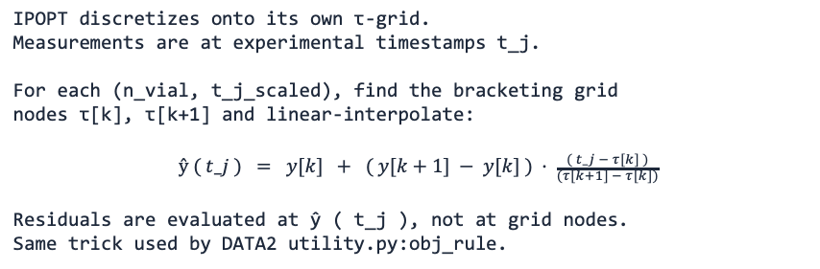
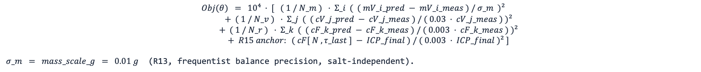
B08 · WSSE OBJECTIVE
18
Weighted least squares + interpolation onto measurement times
OBJECTIVE
(R13, frequentist balance precision, salt-independent).
INTERPOLATION onto MEASUREMENT TIMES
WHY THESE WEIGHTS
IPOPT discretizes onto its own τ-grid. Measurements are at experimental timestamps t_j. For each (n_vial, t_j_scaled), find the bracketing grid nodes τ[k], τ[k+1] and linear-interpolate: $ŷ ( t_j ) = y[k] + ( y[k+1] − y[k] ) · \frac{( t_j − τ[k] )}{(τ[k+1] − τ[k])}$ Residuals are evaluated at ŷ ( t_j ), not at grid nodes. Same trick used by DATA2 utility.py:obj_rule.
MLE interpretation: under independent Gaussian noise N( 0, σ_meas² ) on each residual, the WSSE is the negative log-likelihood up to constants. σ_meas (mass) = 0.01 g (balance precision) σ_meas (vial conc.) = 3 % · cV_meas σ_meas (retentate) = 0.3 % · cF_meas Retentate weight is much tighter than vial weight. The optimizer therefore prioritizes cF fit — and that is one mechanism driving the σ=1 corner basin (see slide 6 and the open-questions slide).
NF270 fitting · backup math layer for ARCHITECTURE.md
18 / 23

Slide 48
B09 · IPOPT + MULTISTART
19
Local NLP solver wrapped in a Latin-Hypercube global heuristic
IPOPT call
LHS multistart (R10 + R12)
solver = _build_ipopt_solver() solver.options["max_iter"] = 3000 solver.options["linear_solver"] = ma57 / mumps results = solver.solve(instance, tee=True) On non-optimal termination, retry with MUMPS + more iter: solver.options["linear_solver"] = "mumps" solver.options["max_iter"] = 5000 solver.solve(instance, tee=True)
lhs = _lhs_unit_hypercube( N, d, seed = 13 ) for k in 1 .. N: θ_k = θ_lo + lhs[k, :] · ( θ_hi − θ_lo ) fit_k = solve_model( θ_k ) best = argmin_k Obj( fit_k ) over optimal-status runs Default N = 5 (runfile accepts 5 .. 14) Lp box = linear [ 5, 8 ] (R12 narrowing) B box = log [ 0.01, 5 ] μm/s σ box = linear ( 0.10, 0.95 ) corners excluded
OBSERVED OBJECTIVE PROGRESSION (NF270_MC2 / NaCl)
Single start Obj = 2.04 × 10⁸ basin: Mode B (σ → 1) LHS multistart (R10, Lp ∈ [5, 14]) Obj = 4.93 × 10⁷ basin: Mode C (σ → 0) LHS multistart (R11 quadrature mass) Obj = 6.08 × 10⁹ basin: Mode B (σ → 1) LHS narrowed (R12, Lp ∈ [5, 8]) + R13 Obj = 4.93 × 10⁷ basin: Mode C (σ → 0) LHS narrowed + R14/R15 Final-Tube anchor Obj = TBD (next run) The Pyomo Var bounds are wider than the LHS box (Lp ∈ (0.5, 50), σ ∈ (0,1)) — LHS only controls where trial starts land, not where IPOPT is allowed to terminate. Local optimum.
NF270 fitting · backup math layer for ARCHITECTURE.md
19 / 23

Slide 49
B10 · MASS-LITMUS BASELINE
20
σ = 0 closed-form Lp regression — convex sanity check
DERIVATION
SLOPE FIT (zero-intercept least squares)
Set σ = 0. The Jw equation becomes algebraic: Jw = Lp · ΔP / 36000 (constant in time) The vial-mass ODE simplifies: d mV / dt = Am · ρ · Jw = Am · ρ · Lp · ΔP / 36000 Integrating: mV ( t ) = s · ( t − t_0 ) s = ( Am · ρ · Lp · ΔP ) / 36000 ⇒ Lp = s · 36000 / ( Am · ρ · ΔP ) All we need is the slope s of mass vs time.
Treat every real-vial sample as an observation of: mV_i = s · Δt_i + noise (no intercept) OLS solution: ŝ = Σ_i ( Δt_i · mV_i ) / Σ_i ( Δt_i )² Implementation: solve_mass_balance_only( data_stru ): Δt = time − vial_start_time ŝ = sum(Δt · mass) / sum(Δt²) Lp̂ = ŝ · 36000 / (Am · ρ · ΔP) return fit_stru, sim_stru No Pyomo, no IPOPT. Always optimal by construction. If THIS fit fails, the issue is data / units / time alignment, not the σ-corner landscape.
NF270 fitting · backup math layer for ARCHITECTURE.md
20 / 23

Slide 50
B11 · FIM & UNCERTAINTY
21
Finite-difference sensitivities, covariance, identifiability
SENSITIVITIES
FISHER INFORMATION
Stack predictions: y ( θ ) = [ mV ; cV ; cF ] For each parameter θ_i, perturb and re-simulate: θ_i± = θ̂_i · ( 1 ± h ), h ≈ 10⁻⁴ ∂ y / ∂ θ_i ≈ ( y( θ_i+ ) − y( θ_i− ) ) / ( 2 h θ̂_i ) Code: calc_FIM( data_stru, mode, theta=θ̂, step=1e-8 ).
Sensitivity matrix: J = ∂ y / ∂ θ (n_obs × n_θ) Measurement covariance: Σ_y = diag( σ_m² , (0.03·cV)² , (0.003·cF)² ) M = J ᵀ · Σ_y⁻¹ · J (Fisher Information) Asymptotic parameter covariance: V_θ ≈ M⁻¹ Eigen-decomposition of M tells you identifiability: large eigenvalues → tightly constrained directions small eigenvalues → flat directions, large variance cond(M) ≫ 1 → correlated / ill-conditioned
FROM LATEST DATA3 RUN
NaCl-MC2 after IPOPT: eig(M) = [ 0.158, 2.776, 907,752 ] (well-conditioned in 1 direction!) eig_dir = [ B, σ, Lp ] std = [ 0.0065, 2.26, 1.25 ] trace = 9.08 × 10⁵ det = 3.99 × 10⁵ cond = 5.7 × 10⁶ σ-direction is flat (std 2.26 with σ ∈ [0,1]) — exactly what the corner-basin behaviour predicts. Lp is the most informative direction, B is the tightest. Identifiability is local: it lives at the fitted θ̂, under the assumed σ_meas.
NF270 fitting · backup math layer for ARCHITECTURE.md
21 / 23

Slide 51
B12 · RUNFILE DISPATCHER
22
Tree walker — ROOTS → SUBSET → TRUNK → BRANCHES → dispatch
refactored_ucb_runfile.py (≈ 184 lines, no science inside)
def main(): root = pick_root() # 1=DATA1 2=DATA2 3=DATA3 4=custom subset = pick_subset(root) # DATA3: all 26 / single-salt 11 / one sheet / fast 3 trunk = pick_trunk() # 0=manifest_default 3=fit+multistart 4=+FIM 5=+DoE 6=mass-litmus branches = pick_branches() # m=mass c=conc p=params f=FIM d=DoE all if root in {1, 2, 3} and trunk == 0: # exact byte-identical replication of published outputs materialize_all( root, subset, branches ) elif root in {1, 2, 3} and trunk in {3, 4, 5}: results = estimate_parameters( root, subset, multistart=True, use_FIM=(trunk≥4), use_DoE=(trunk==5) ) render( results, branches ) elif root in {1, 2, 3} and trunk == 6: # NF270 mass-litmus baseline (sets NF270_MASS_LITMUS_TEST_ACTIVE = True) results = solve_mass_balance_only( load(root, subset) ) render( results, branches ) elif root == 4: # custom XLSX outside the campaign manifest results = run_pipeline( file_path, mode, workflow_family ) render( results, branches ) No physics, no Pyomo, no IPOPT call lives in this file. Replace it with a notebook, a CLI, a web form — the library does not care. All dispatch happens through the kept top-level def-s in refactored_ucb_library.py.
NF270 fitting · backup math layer for ARCHITECTURE.md
22 / 23

Slide 52
B13 · CAVEATS
23
Things to scrutinize before trusting any DATA3 fit
OBJECTIVE WEIGHTS DOMINATE THE ANSWER
cVmV TRICK IS LATENT
Retentate 0.3 % is very tight. Permeate 3 % is loose. Mass 0.01 g is tight on the vial-1 scale (≈ 1 g) but loose on the cell scale (≈ 10 g). Optimizer will prioritize whichever residual has the smallest σ_meas — this is the most common silent failure mode in WSSE parameter estimation.
The fact that the model uses cVmV instead of cV is the difference between an IPOPT solve that succeeds in 6 iterations and one that diverges trying to evaluate 0 / 0. Worth knowing if you refactor the state.
IPOPT IS LOCAL
MASS-LITMUS IS EXCELLENT ENGINEERING
Multistart is a heuristic, not a guarantee. If the loss-function landscape globally prefers a σ corner, every LHS start will find it. Diagnose by tightening σ to [0.30, 0.85] and checking whether Obj jumps up.
A convex closed-form baseline that bypasses Pyomo / IPOPT entirely. If mass-litmus fails, the full fit cannot succeed — issue is in loader, units, or data quality. If it succeeds but the full fit fails, issue is σ-coupling or the optimization landscape.
UNIT CONVERSIONS ARE EVERYWHERE
FIM IS LOCAL
The 36000 in Jw and the 10000 in Js are not cosmetic. They encode the unit system bridging L/(m²·hr·bar) → cm/s and μm/s → cm²·mM-per-time. A wrong factor changes fitted Lp / B / σ silently. No warning will fire.
Meaningful only near θ̂ and under the assumed σ_meas. Reported eigenvalues / stds describe local identifiability, not global uncertainty. For global uncertainty, profile likelihood is the frequentist-clean upgrade.
NF270 fitting · backup math layer for ARCHITECTURE.md
23 / 23

Slide 53


Membrane Characterization using a Digital Model
Prior
Knowledge
Experimental Data
Parameter Estimation
Sensitivity & Uncertainty Analysis
Uncertainty Acceptable?
Model with Quantified Uncertainty
Yes
Model(s)
No
Model-Based Design of Experiments
• Dotted lines ⇢ manual data transmission
• Solid lines → automatic data transmission
Notes:
“Membrane characterization can be formulated as a dynamic inverse problem, where we estimate transport parameters from time-resolved experimental data.”
“However, these parameters are often poorly identifiable due to strong correlations, which leads to an ill-conditioned inference problem.”
“To address this, we adopt a closed-loop uncertainty quantification framework.”
👉 (point to diagram)
“We estimate parameters using weighted least squares, quantify uncertainty through sensitivities and the Fisher Information Matrix, and then design new experiments to improve identifiability.”
“This creates a sequential learning loop.”
Final line (slow down):
“Our goal is to reshape the information geometry of the problem so that the parameters become identifiable.”

Slide 54
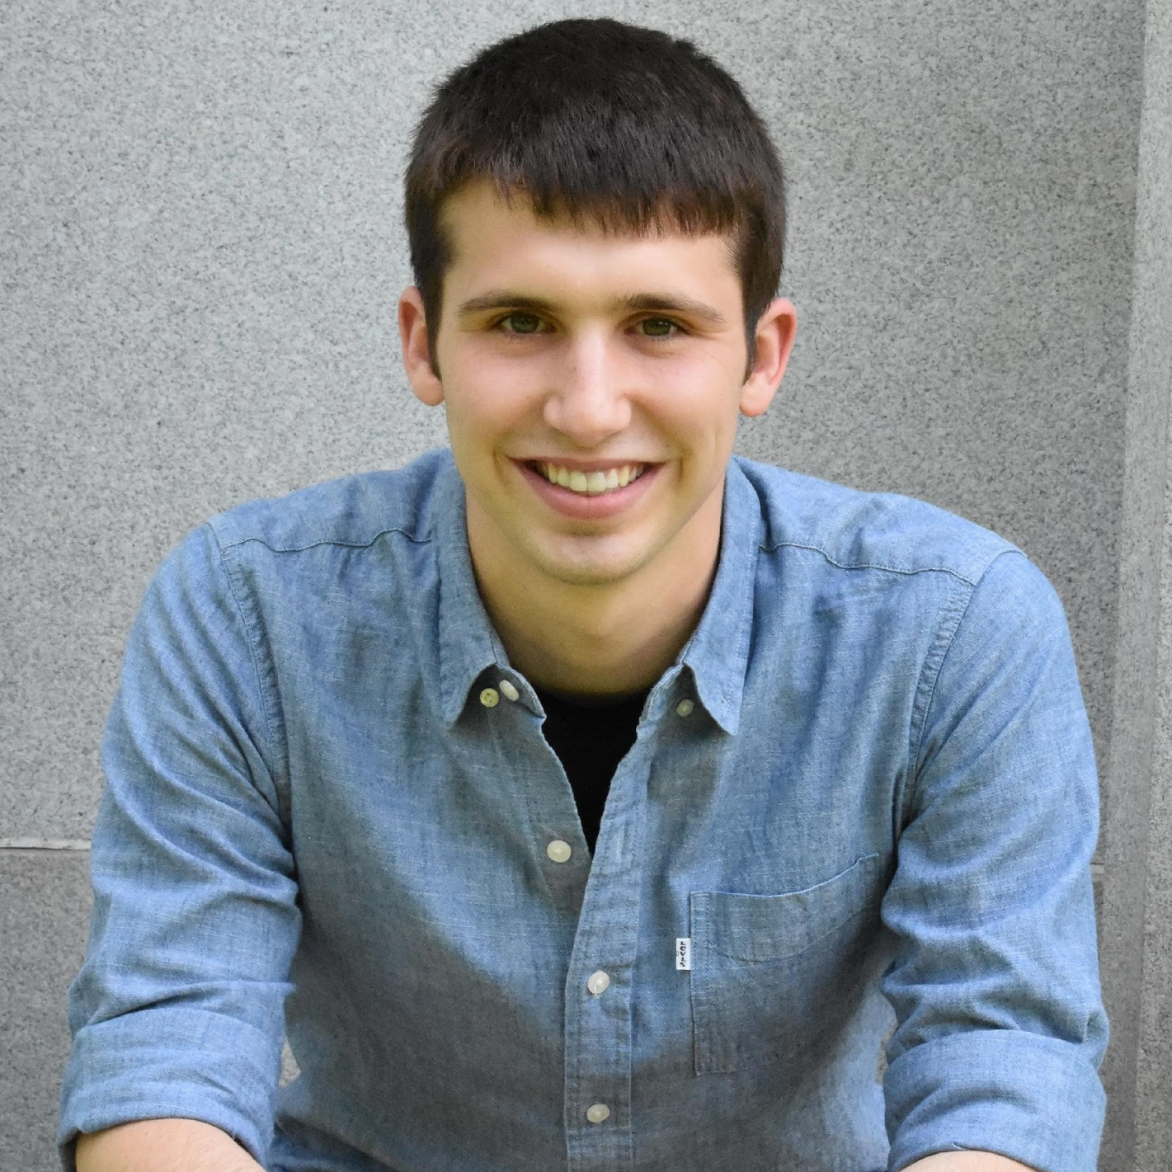

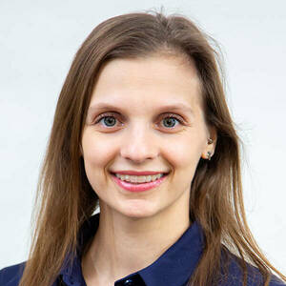
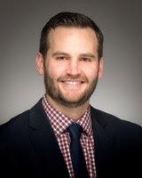
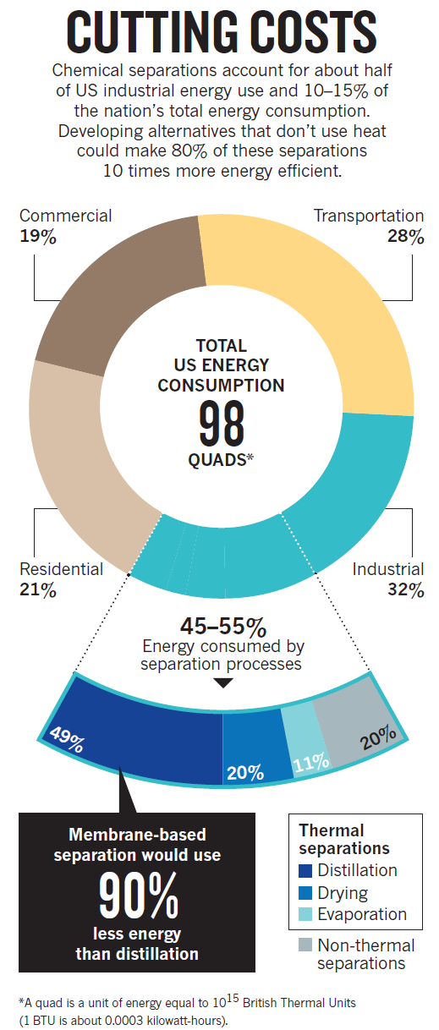
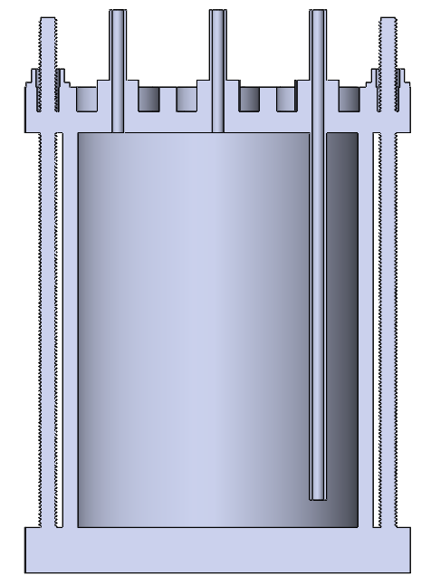
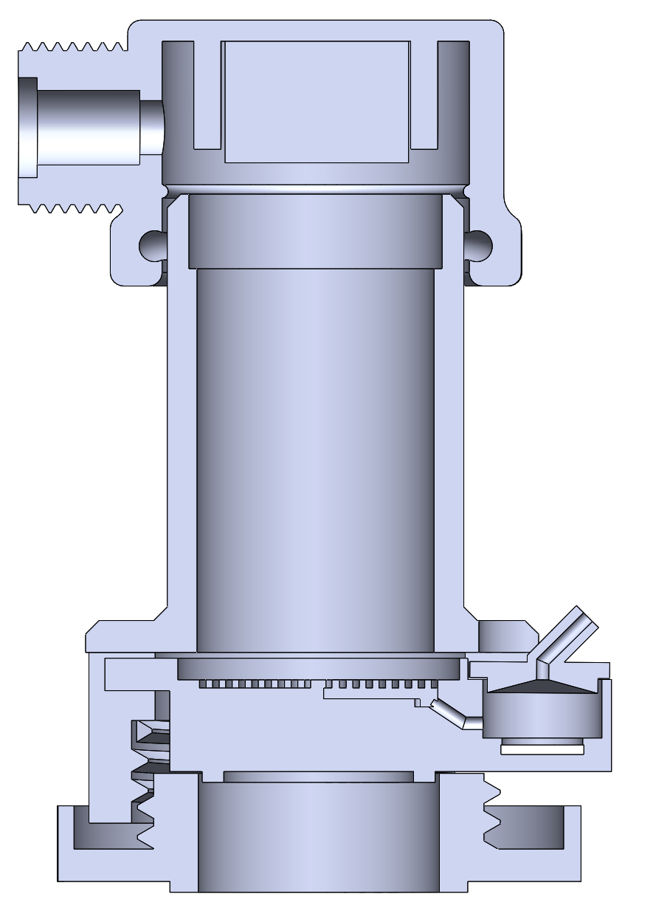
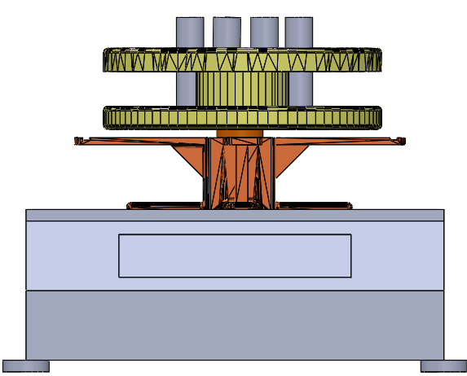
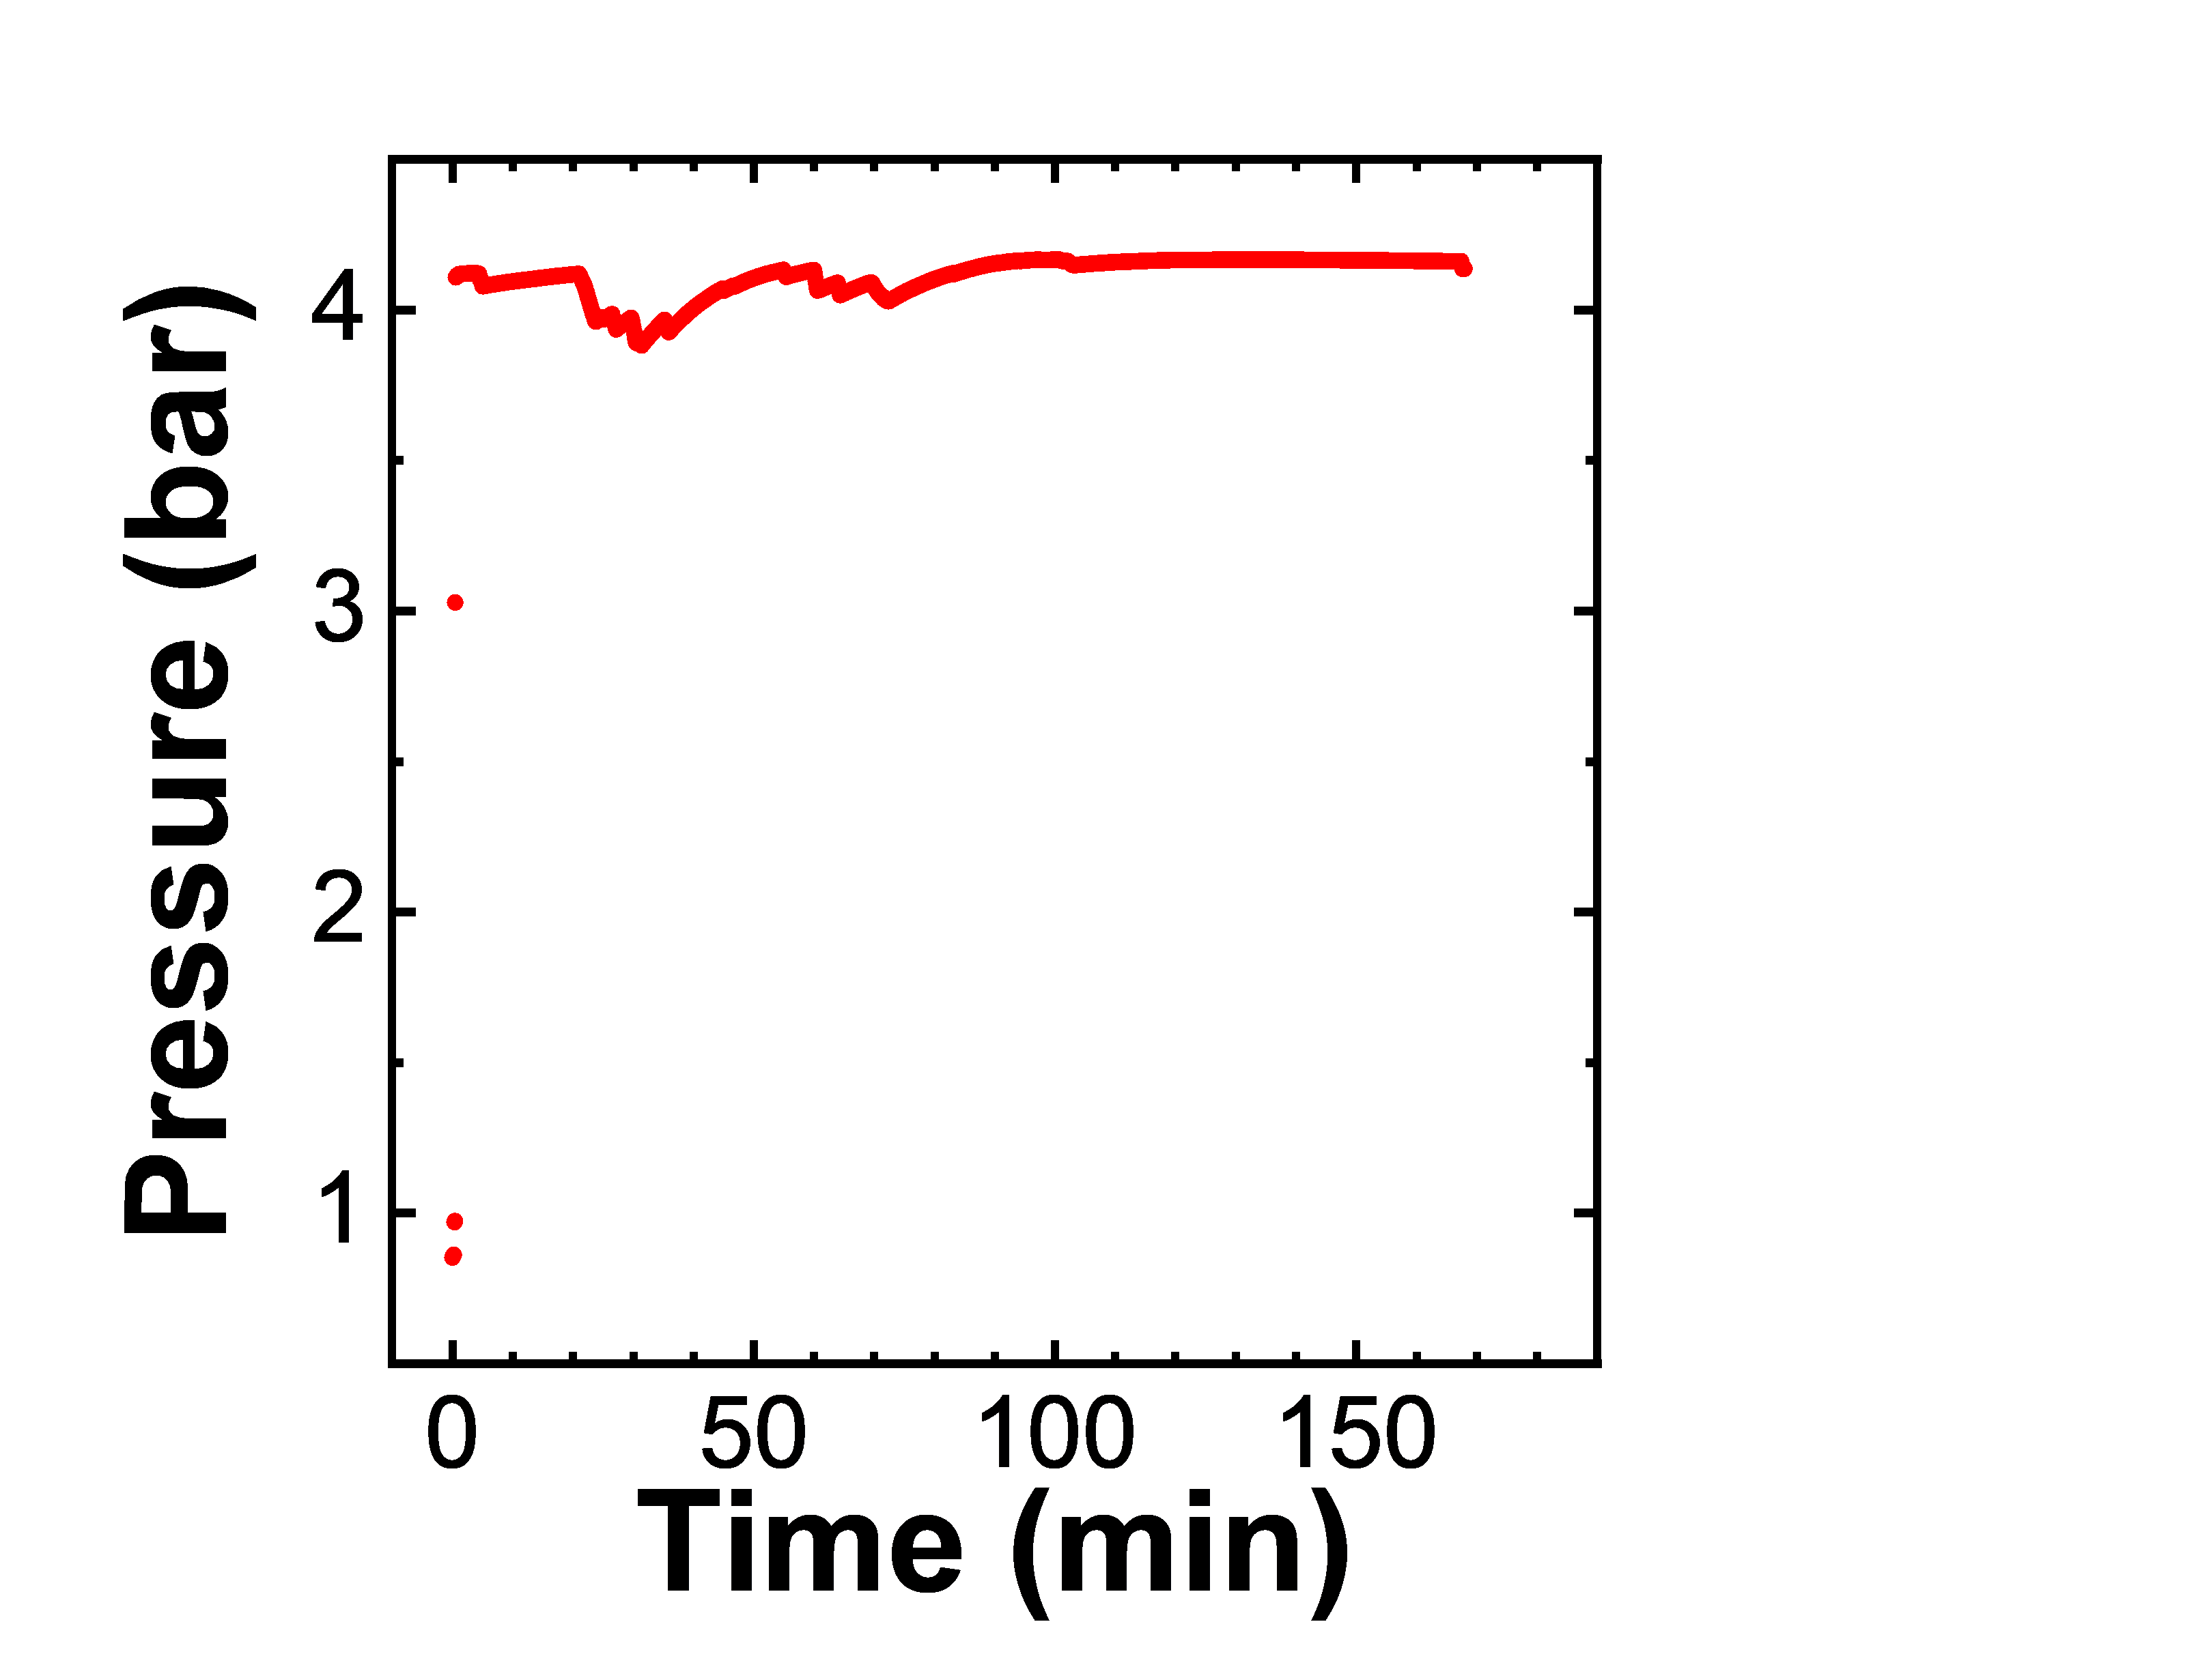
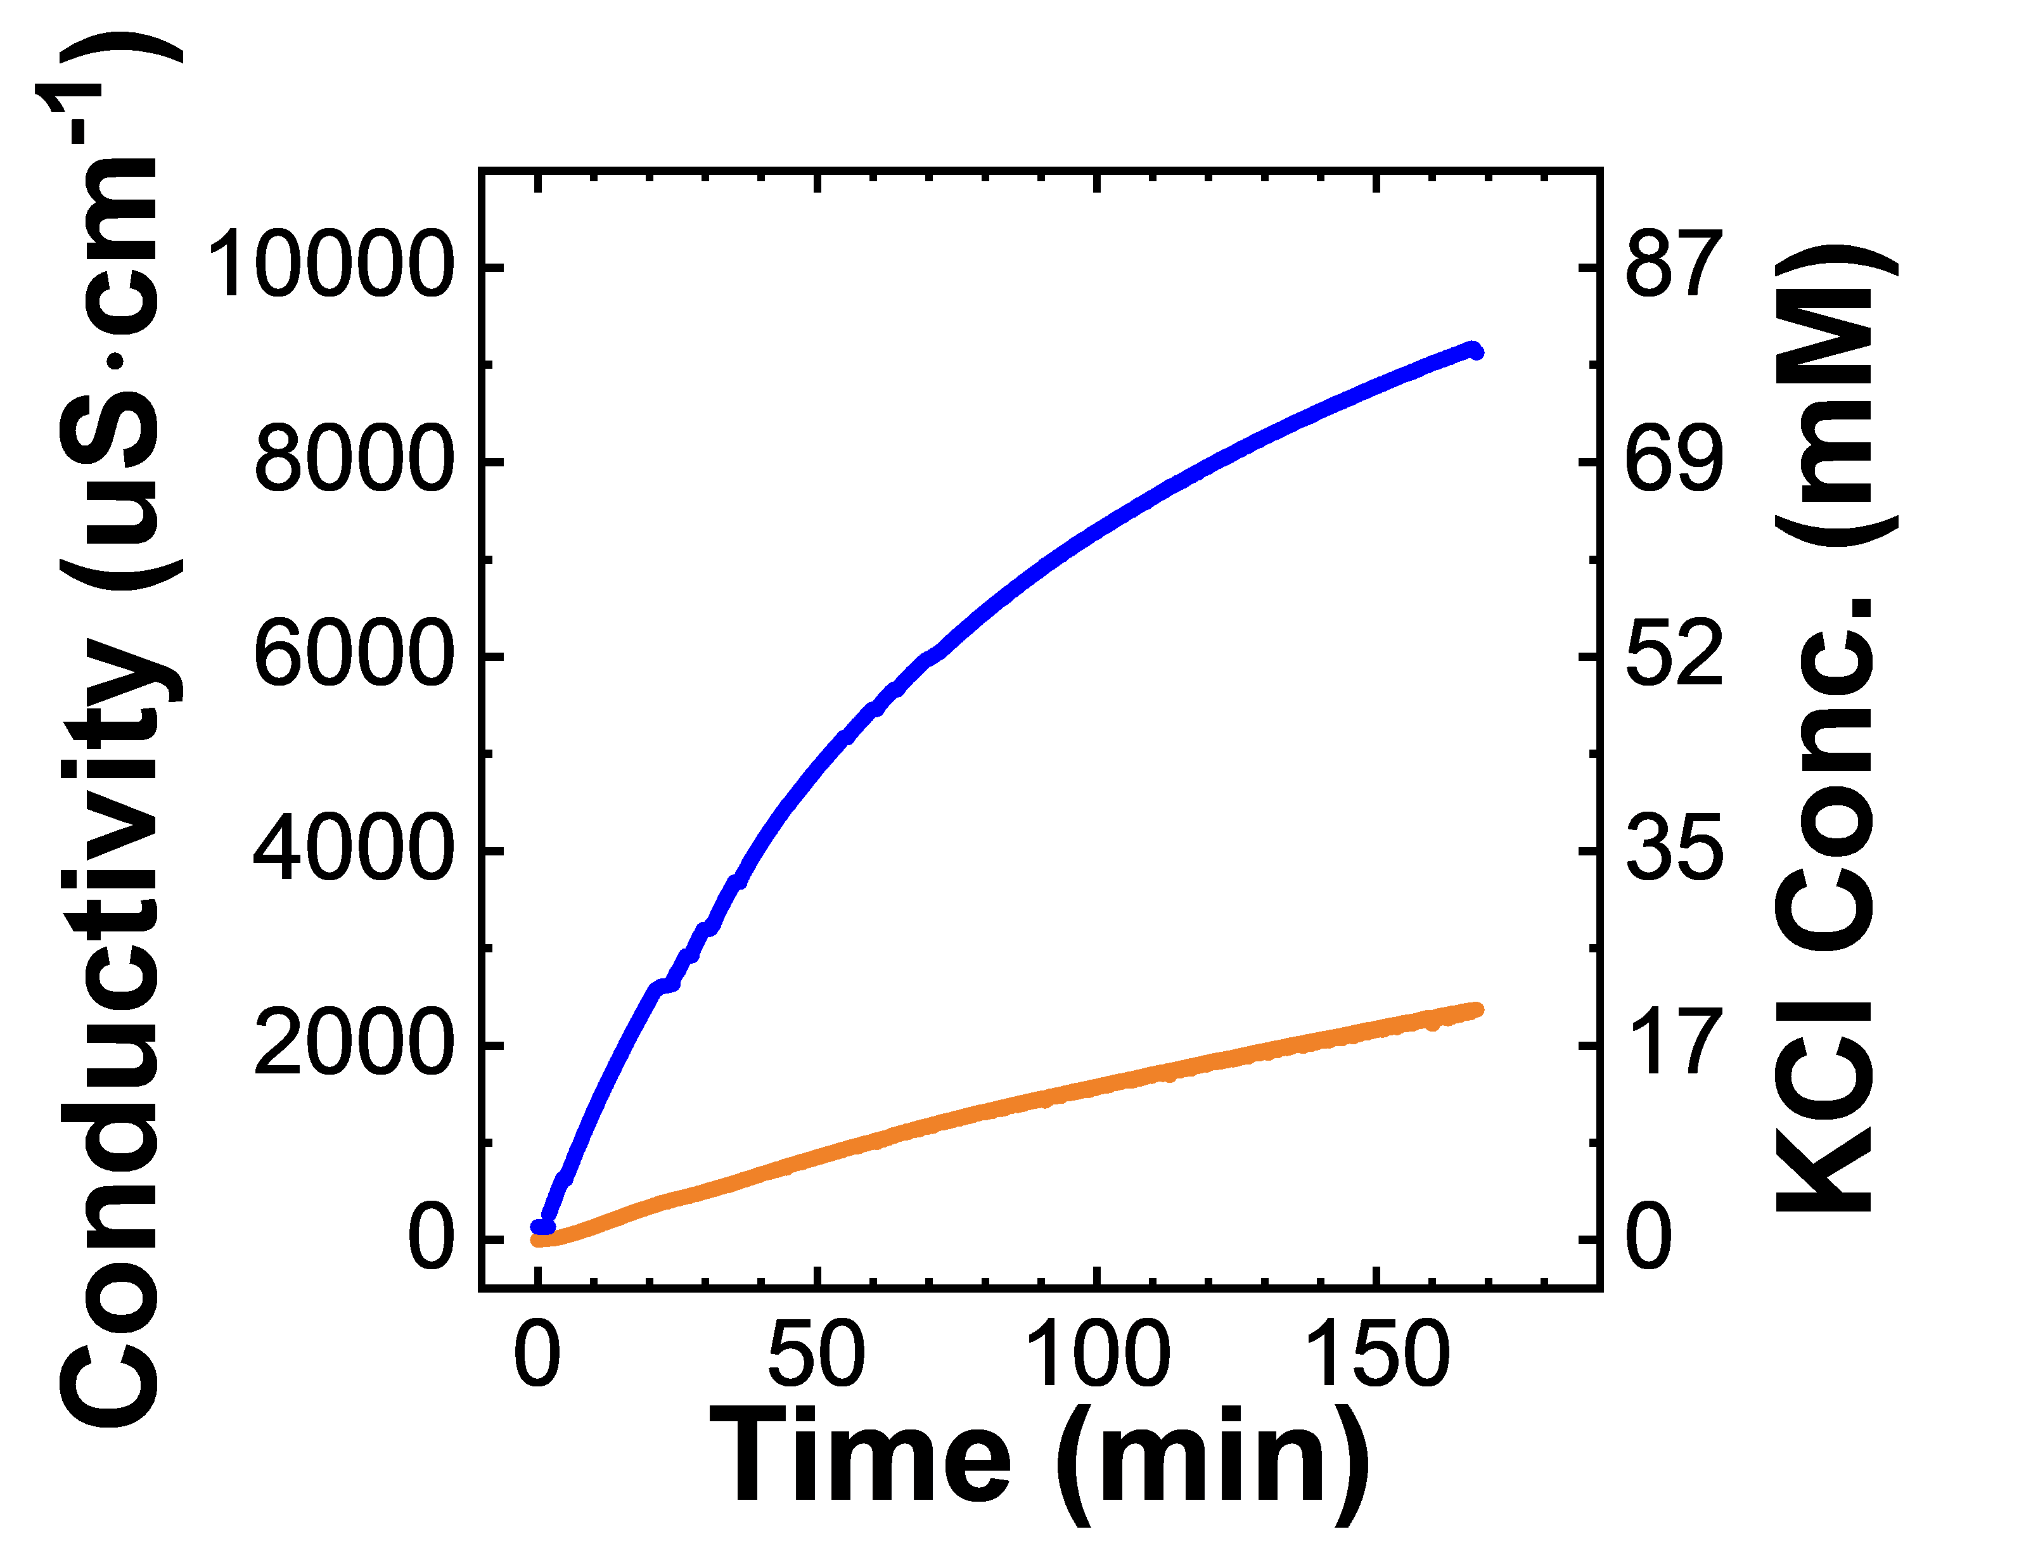
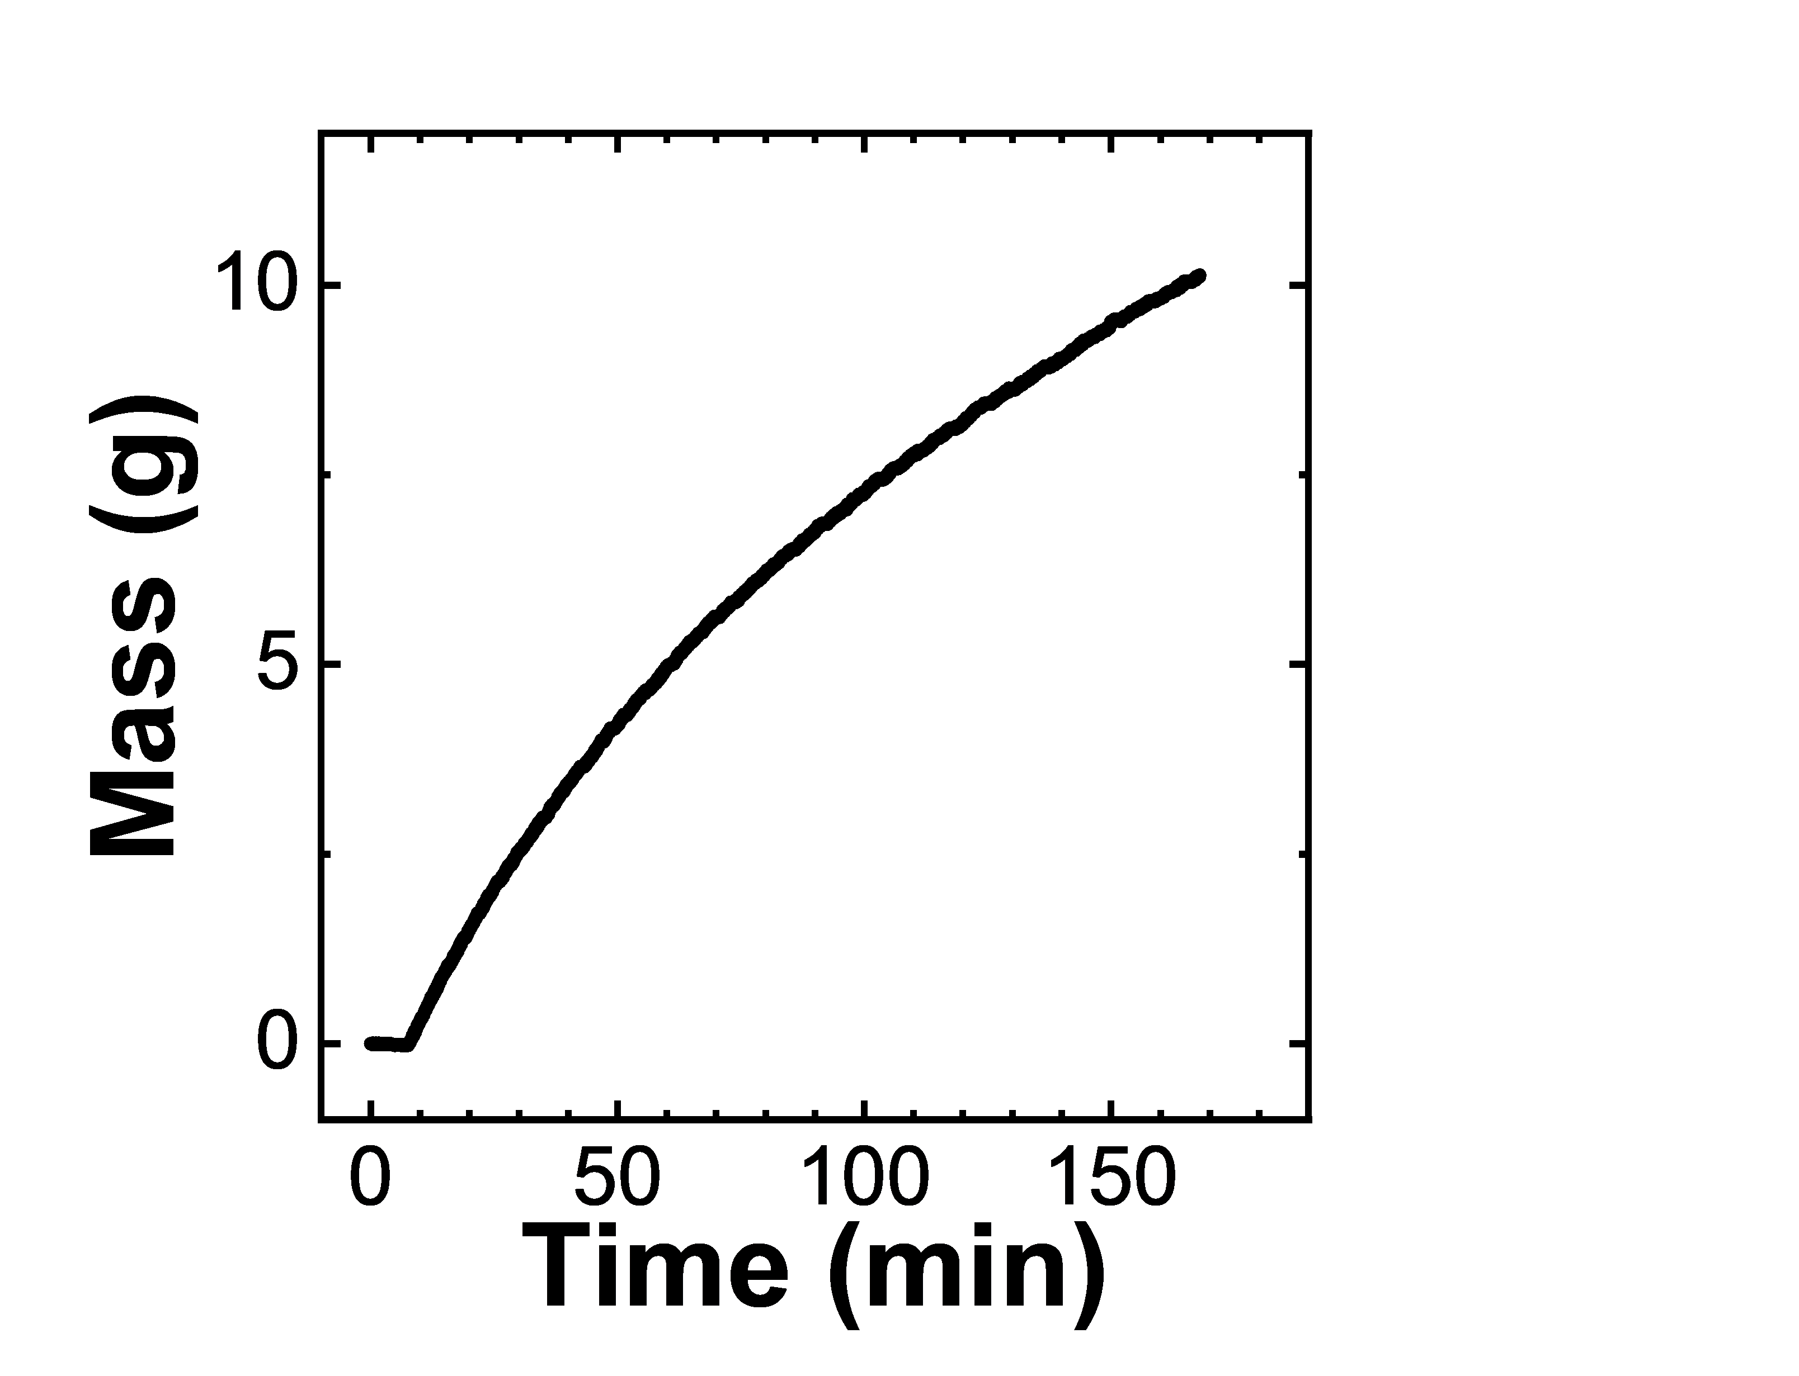
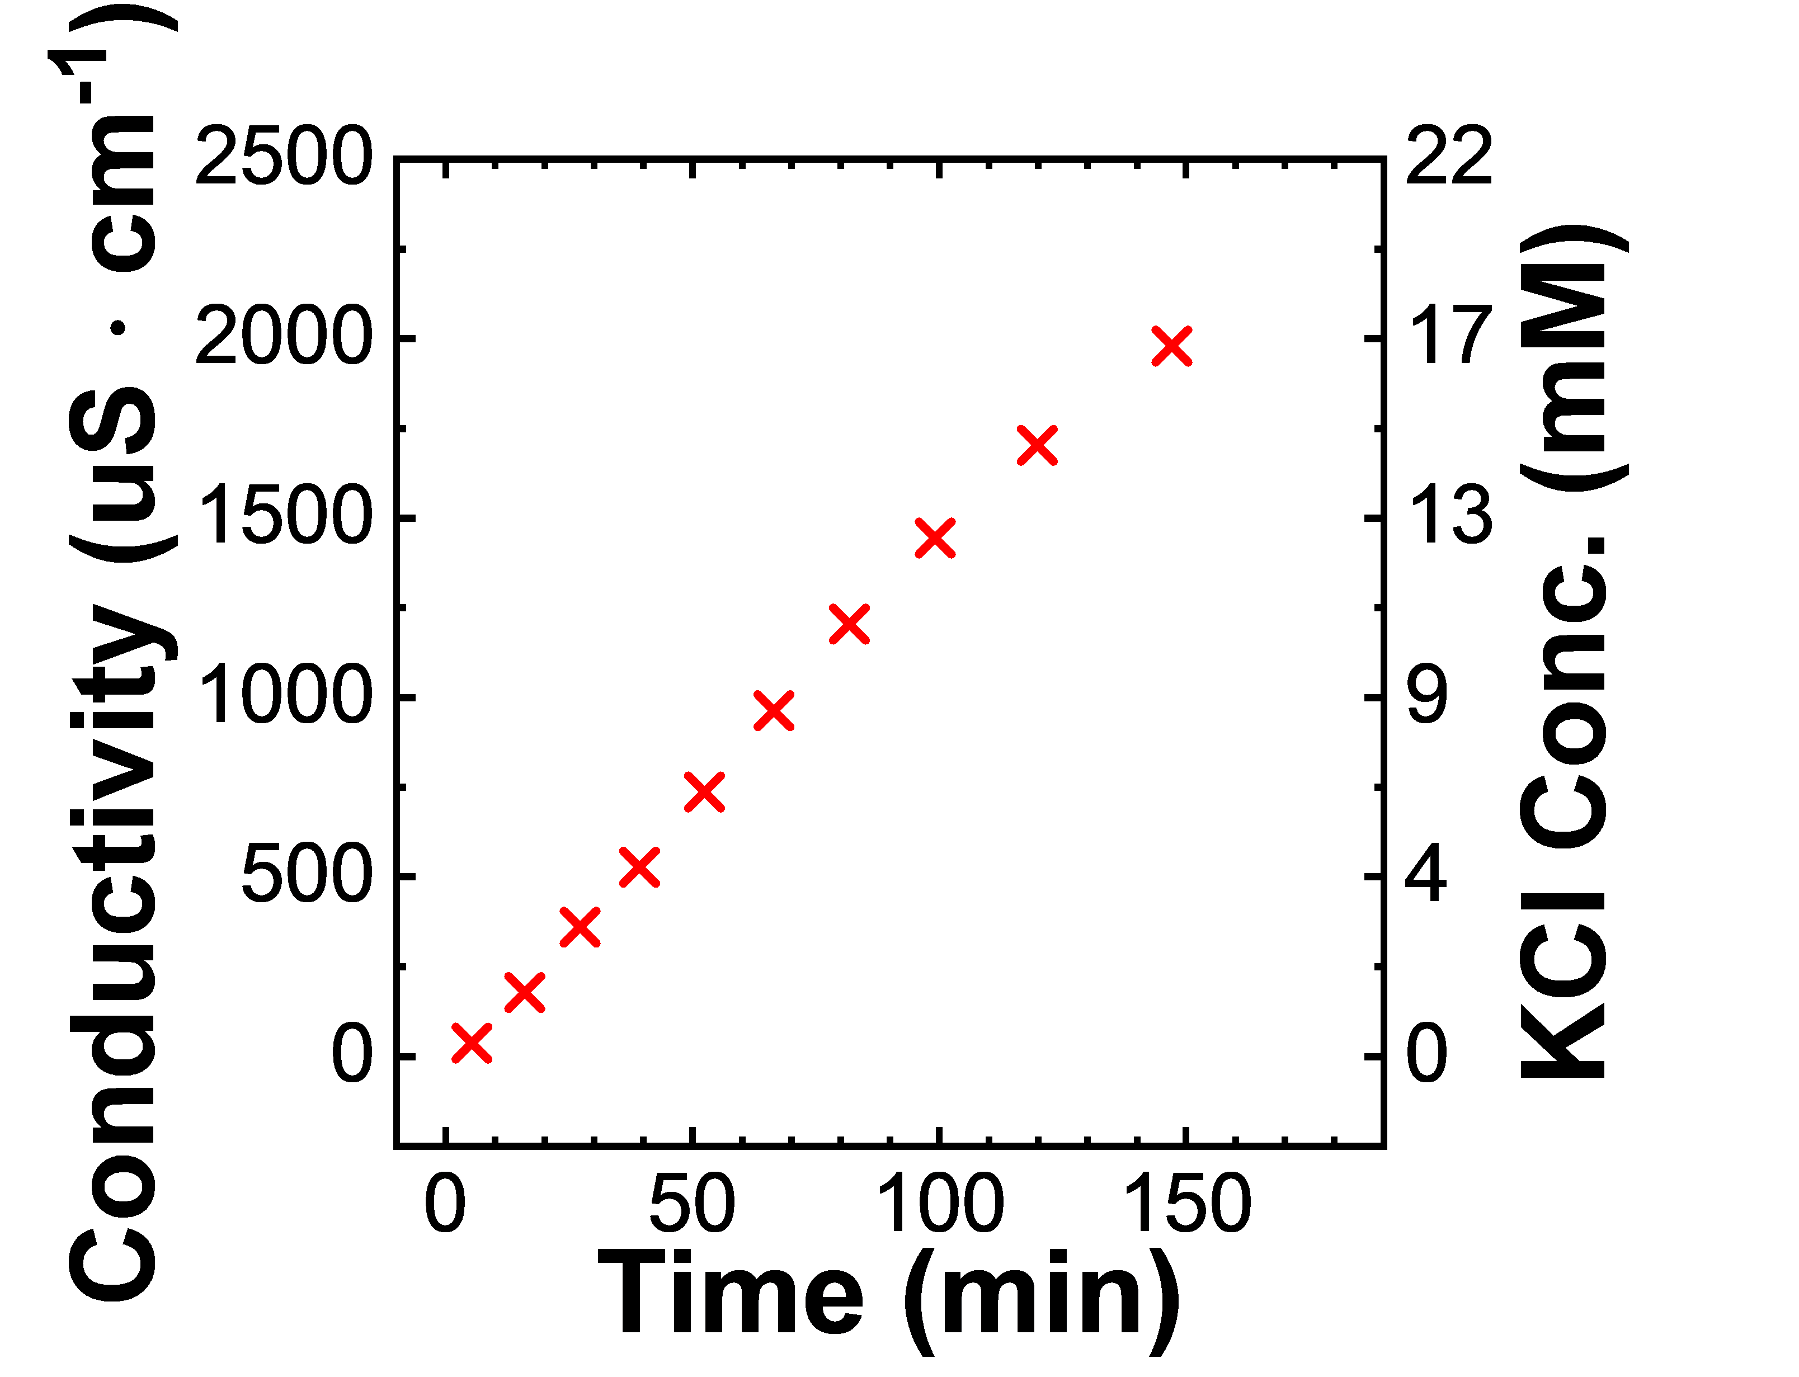

Separation using a Dynamic Diafiltration Device
Pressure Relief Valve
P
Pressure Gauge
Stirred Cell
Scintillation Vials
Diafiltrate Tank
Permeate Outlet
Motor
Retentate Probe
Balance
Membrane
Permeate Probe

Slide 55
Pressure Relief Valve
P
Pressure Gauge
Stirred Cell
Scintillation Vials
Diafiltrate Tank
Permeate Outlet
Motor
Retentate Probe
Balance
Membrane
Permeate Probe

Slide 56
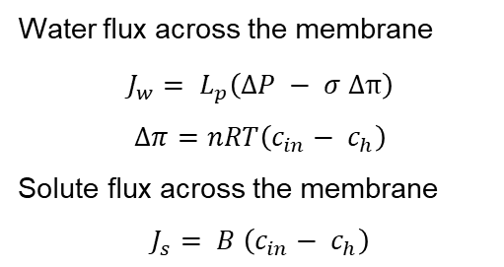
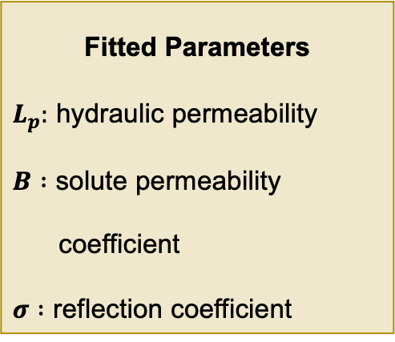
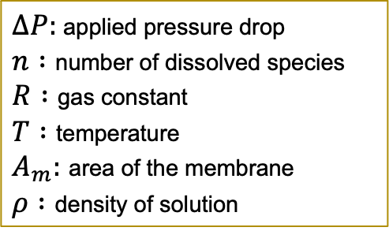
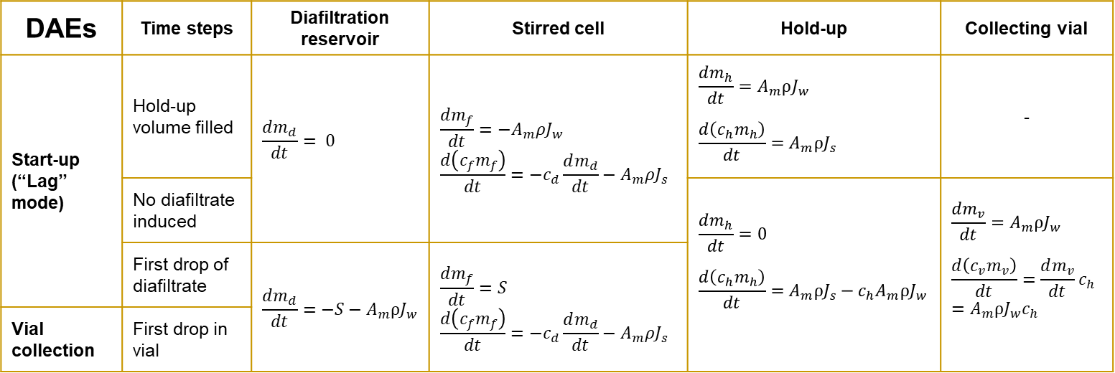
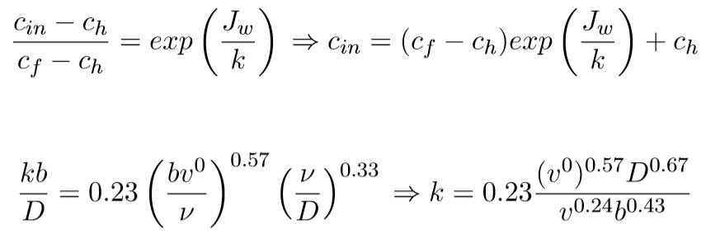
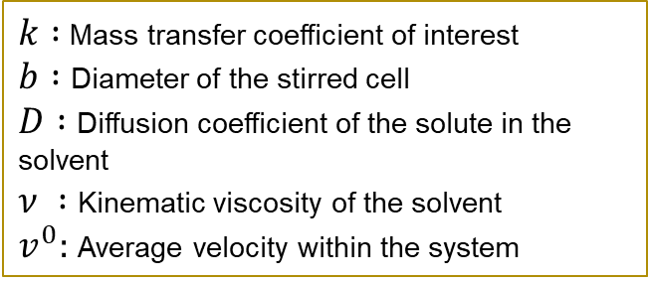
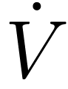
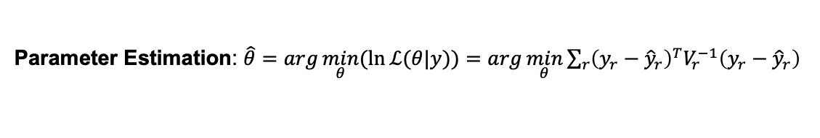
Dynamic Model w/ Lumped Parameter Infers Membrane Properties
Concentration
polarization
Parameter Estimation: $\hat{θ}=\arg{\min_{θ}{(\ln{ℒ(θ|y)})}}=\arg{\min_{θ}{\sum_{r}{{\left(y_{r}−{\hat{y}}_{r}\right)}^{T}V_{r}^{−1}\left(y_{r}−{\hat{y}}_{r}\right)}}}$

Slide 57
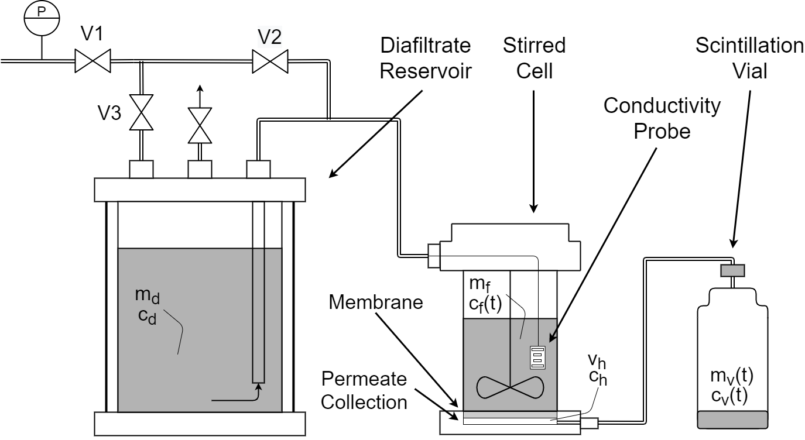
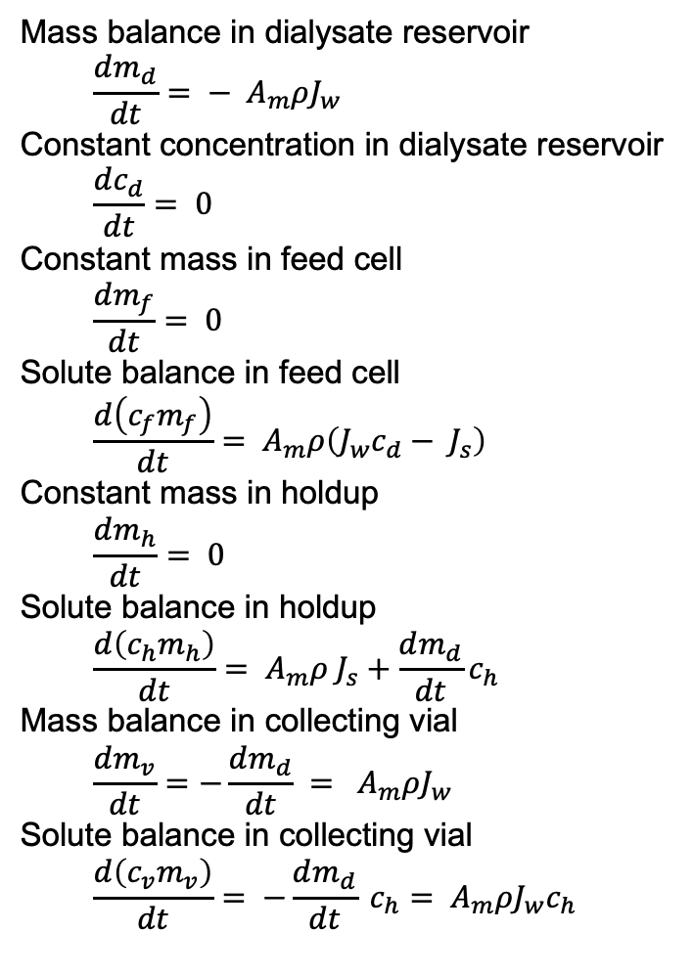
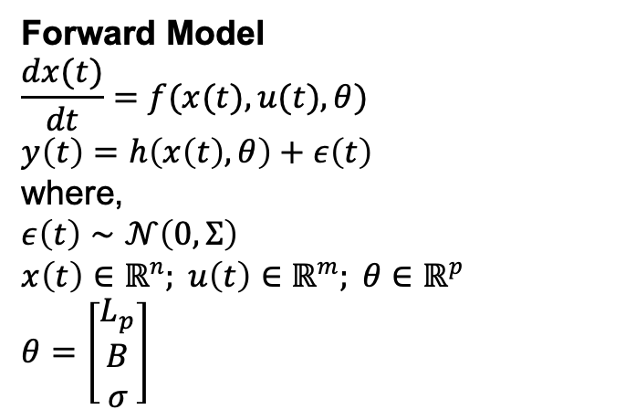
Lumped Parameter Model Infers Membrane Properties
Forward Model
$$\frac{dx(t)}{dt}=f(x(t),u(t),θ)$$ $y\left(t\right)=h\left(x\left(t\right),θ\right)+ε\left(t\right)$
where, $$ε\left(t\right)∼𝒩\left(0,Σ\right) \\ x\left(t\right)∈ℝ^{n}; u\left(t\right)∈ℝ^{m}; θ∈ℝ^{p}$$
$$θ=\left[\begin{aligned}L_{p} \\ B \\ σ\end{aligned}\right]$$
Concentration polarization
[Fig.] Ouimet, J. A. et. al., (2022). Journal of Membrane Science, 641, 119743.
Notes:
model parameters, hydraulic permeability Lp, solute permeability coefficient B that correspond to the membrane transport properties,
and reflection coefficient sigma that depends on the thermodynamics of the membrane-solution interface.

Slide 58
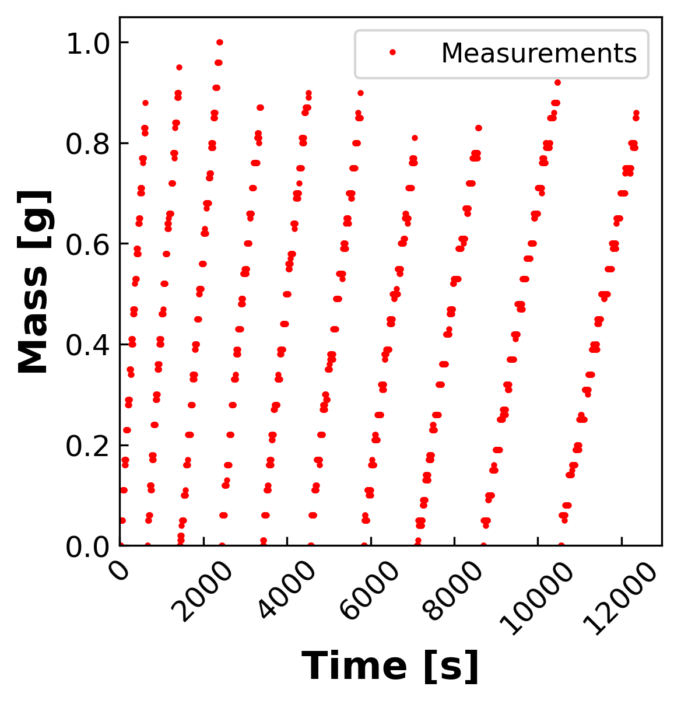
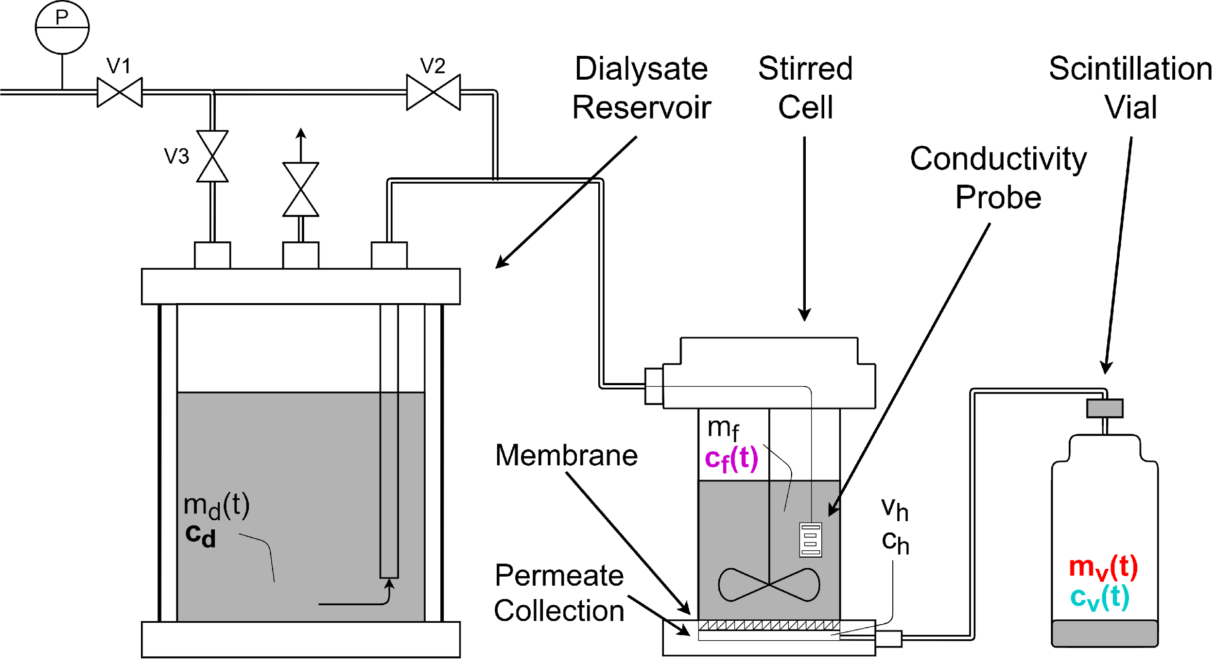
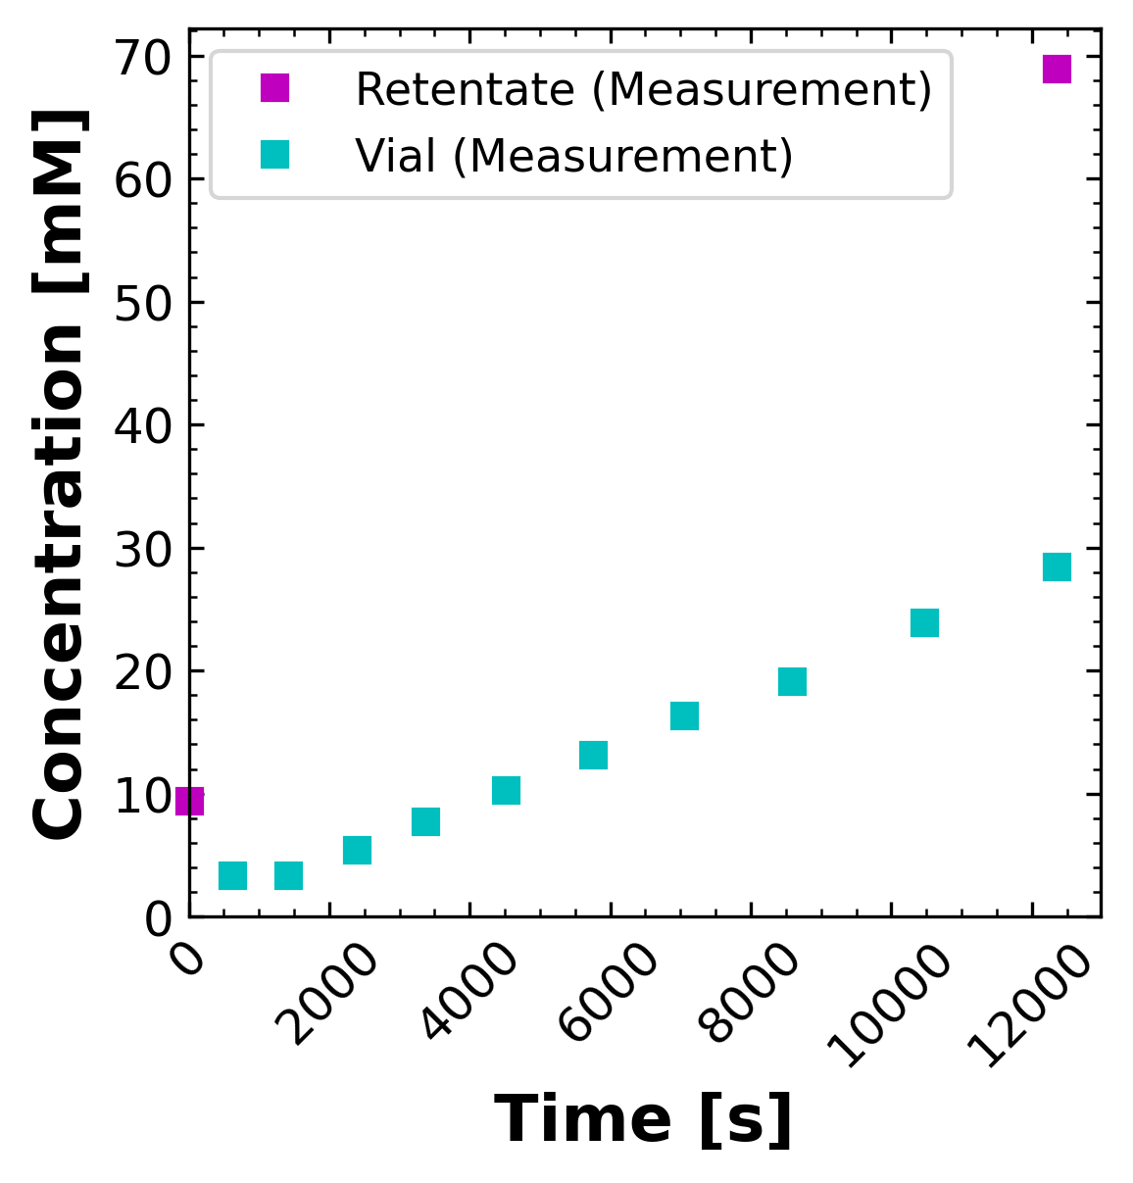
Dynamic Diafiltration Experiment Sweeps Larger Concentration Space 5x Faster Than Filtration Experiments
Diafiltrate Reservoir

Slide 59
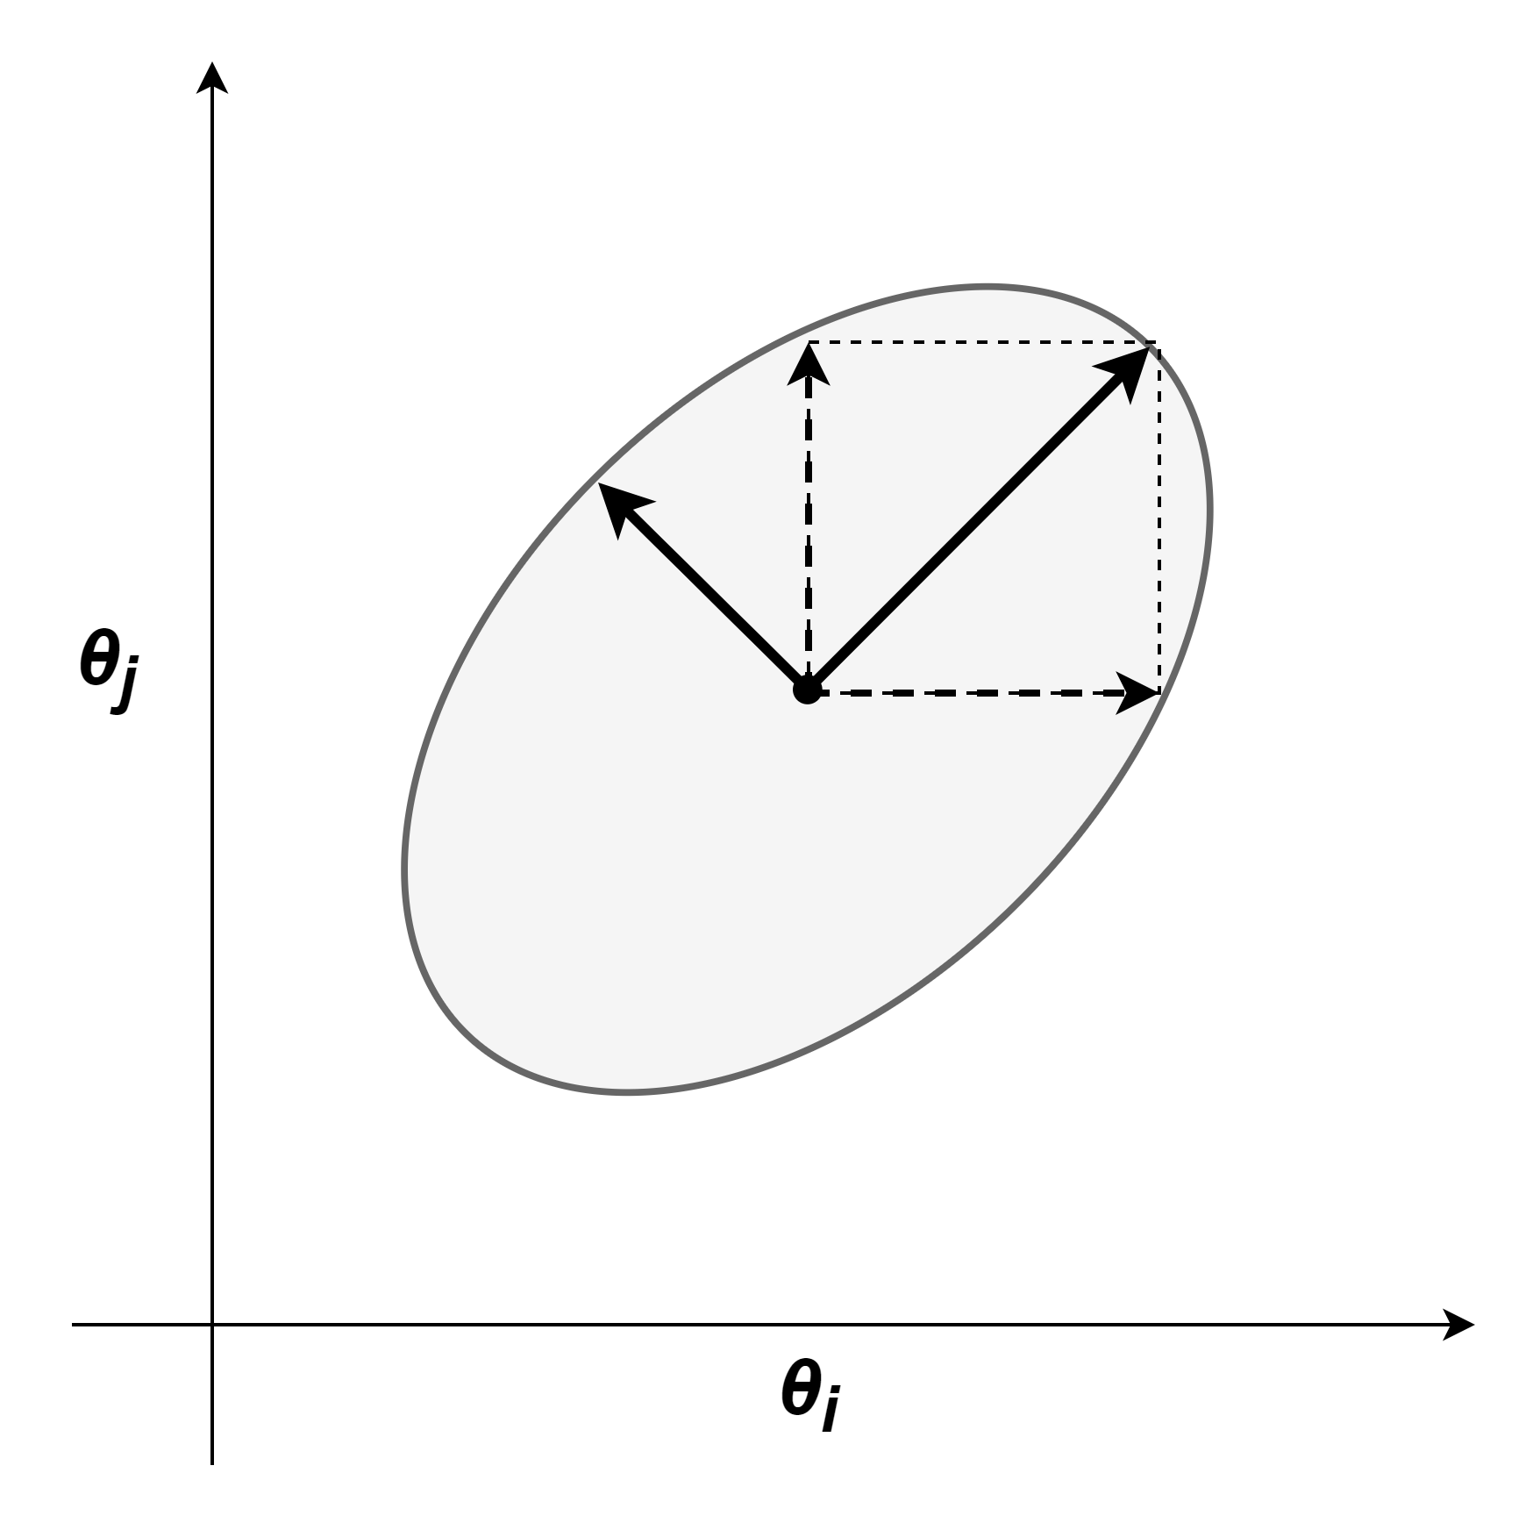

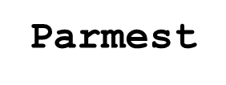
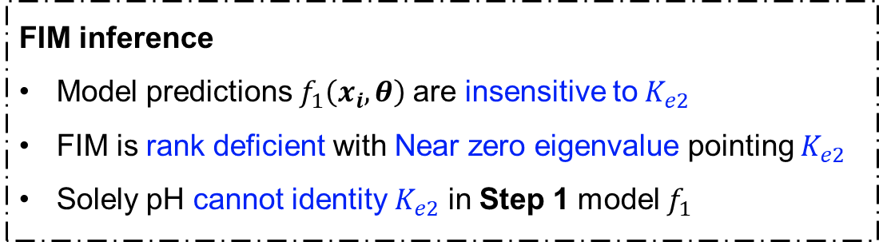
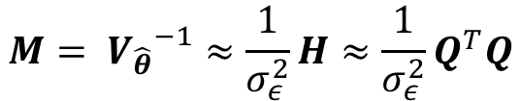
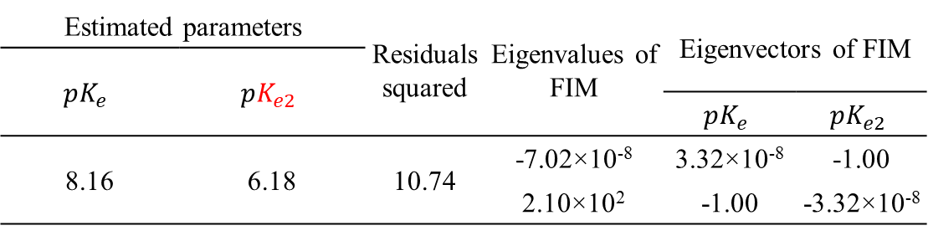

FIM Highlights Nonidentifiable Parameters
Fisher information matrix (FIM)
Estimated parameters |  | Residuals squared | Eigenvalues of FIM | Eigenvectors of FIM
$$pK_{e}$$ | $$pK_{e2}$$
 |  |  |  | $$pK_{e}$$ | $$pK_{e2}$$
8.16 | 6.18 | 10.74 | -7.02×10⁻⁸ | 3.32×10⁻⁸ | -1.00
 |  |  | 2.10×10² | -1.00 | -3.32×10⁻⁸
$$M= {V_{\hat{θ}}}^{−1}≈\frac{1}{σ_{ε}^{2}}H≈\frac{1}{σ_{ε}^{2}}Q^{T}Q$$
Confidence ellipse for covariance matrix
$$V_{\hat{θ}}= M^{−1}$$
FIM inference
Model predictions $f_{1}\left(x_{i},θ\right)$are insensitive to$K_{e2}$
FIM is rank deficient with Near zero eigenvalue pointing $K_{e2}$
Solely pH cannot identity $K_{e2}$ in Step 1 model $f_{1}$

